Slide 1
The relationship between column water vapour and climatic variables in the East Asian summer monsoon (EASM) region
Lintao Li, Albertus J. Dolman
VU University Amsterdam
l.li@vu.nl
Notes:
Today I am going to talk about the relationship between column water vapour and climatic variables in the East Asian summer monsoon (EASM) region.

Slide 2
Outline
Study aims
Data & methods
Relationship with various variables
Dominant climatic processes on CWV
Summary
Notes:
There are five parts in my talk.

Slide 3
Outline
Study aims
Data & methods
Relationship with various variables
Dominant climatic processes on CWV
Summary

Slide 4
Study aims
What factors are important for the amount of water vapour in the atmosphere ?
The relative importance among these important factors.
Notes:
We know that water vapour is important. It provides the single largest greenhouse effect on the Earth’s climate. The latent heat released during its condensation significantly affects the atmospheric circulations.
Since water vapour is quite important, we may also want to know ...

Slide 5
Outline
Study aims
Data & methods
Relationship with various variables
Dominant climatic processes on CWV
Summary

Slide 6
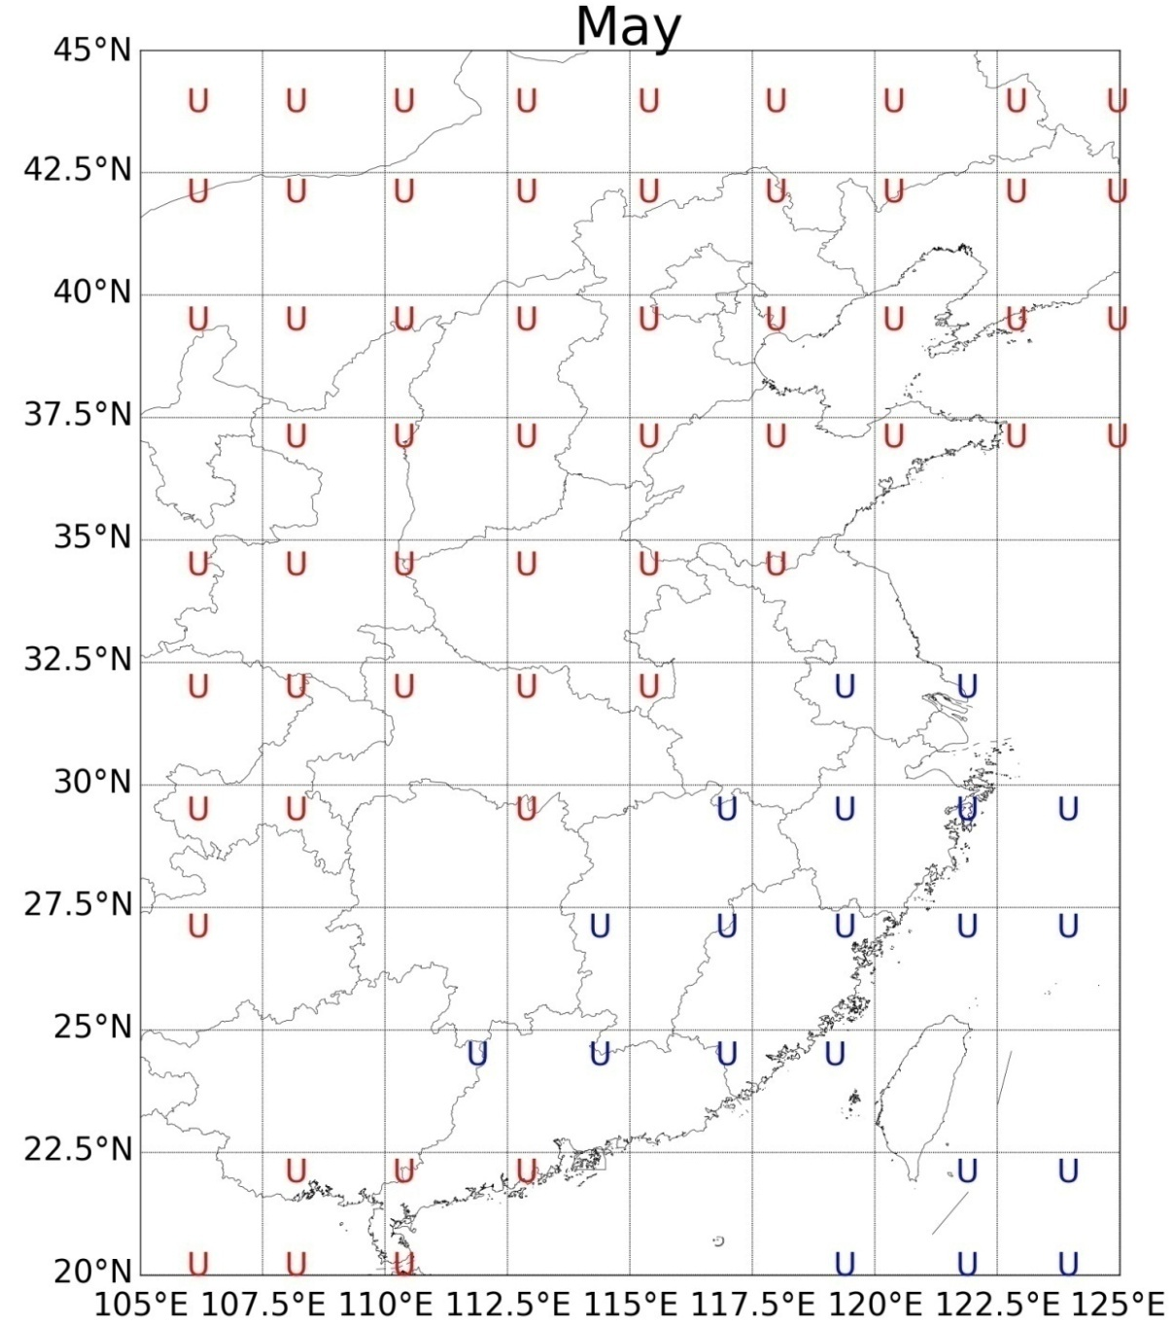
Data & methods
zonal (U) and meridional (V) wind components at 850 hPa;
air temperature at 850 hPa (T_850);
sea surface temperature (SST);
outgoing longwave radiation (OLR);
accumulated total evaporation (E);
the 2 meter temperature (T_2).
Resolution: 2.5° × 2.5°
Time period: from January 1979 to December 2013
Study area: the East Asian summer monsoon (EASM) region, which is defined commonly as the region bounded by 105°-125°E and 20°-45°N (Sun et al.2014).
Notes:
We investigate the relationships between summer time column water vapour (CWV) and seven climatic variables.
These variables describe both water vapour supply and the sustaining processes.
For example, winds can blow water vapour into a region, they can also blow water vapour away from a region. These are supply and remove processes.
We use grid data of resolution at 2.5° × 2.5°

Slide 7
Methods
stepwise regression analysis | proportional marginal variance decomposition (PMVD)
Select important variables | compare the importance among the selected variables
Notes:
For the first purpose, We use stepwise regression analysis to select variables important to the vapour content for each grid over the EASM region;
For the second purpose, we use the proportional marginal variance decomposition (PMVD) method to compare the importance of the selected variables.

Slide 8
Outline
Study aims
Data & methods
Relationship with various variables
Dominant climatic processes on CWV
Summary
Notes:
There are five parts in my talk.

Slide 9
zonal wind component (U)
Notes:
This figure shows relationships between uwinds and CWV in May.
Regions with a letter U indicate uwind is important for the CWV, without the letter U means uwind is not important.
Red colour of the letter U indicates negative relationship and blue indicates positive.
To understand these outputs better, we need some basic ideas about the East Asian summer monsoon.

Slide 10
Li L, Dolman A J, Xu Z (2016)
Notes:
There are three branches of monsoon over the East Asia. The uwind components are basicly from the southwest and southeast monsoon branches. When the southwest monsoon is stronger, water vapour mainly comes from the Indian Ocean, the relationship between CWV and uwind is positive. When the southeast monsoon is stronger, the relationship is negative.

Slide 11
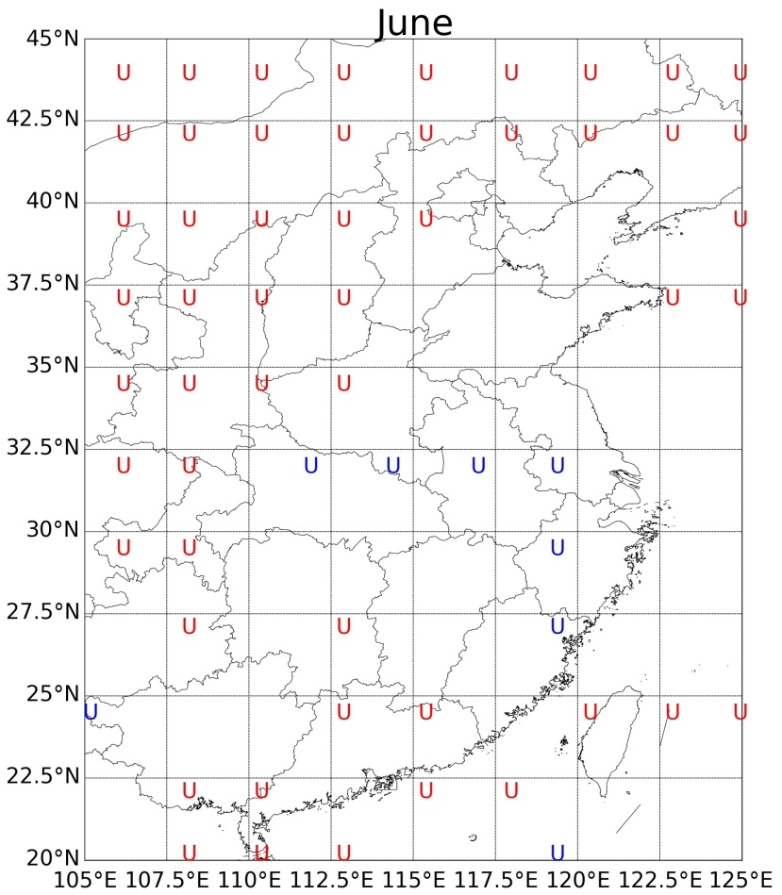
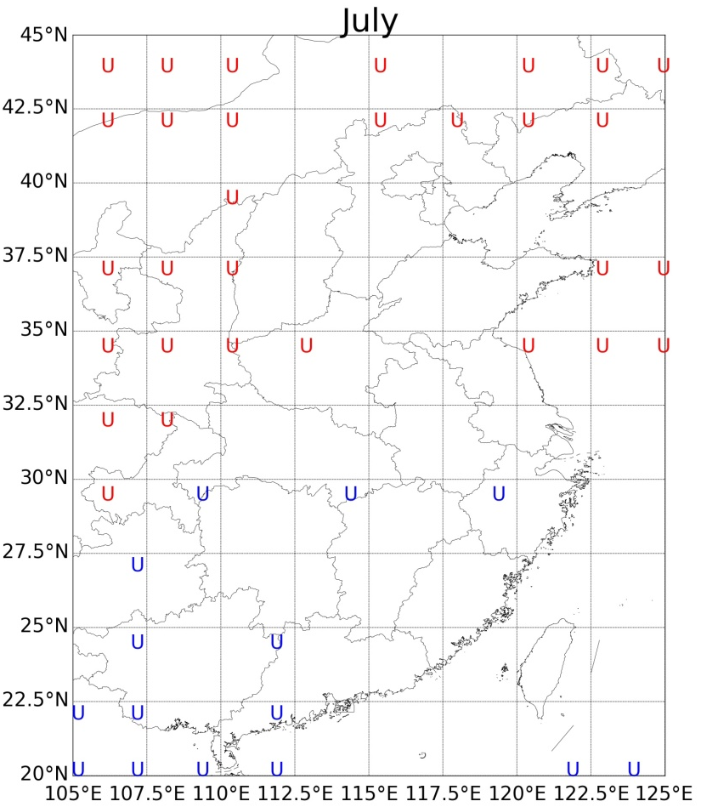
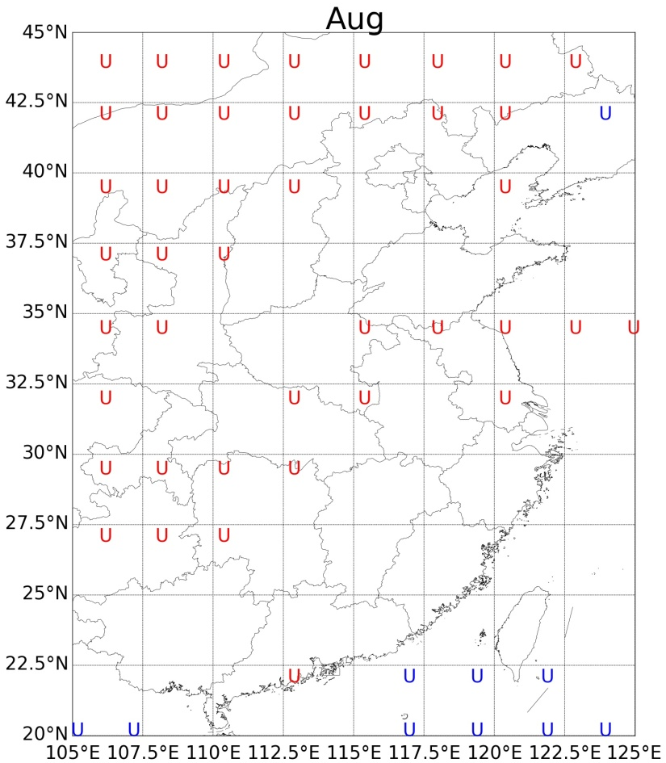
zonal wind component (U)
Zonal wind can either contribute water vapour to or remove from the atmosphere, depending on its position and thus its character in the general circulations.
Notes:
Keeping this idea in mind, we can find out that the southwest monsoon is stronger in May. Overall, the uwind is positively related to the CWV. For June, the southeast monsoon is stronger in the southeast regions and the southwest monsoon is stronger in the central regions where negative and positive relationships can be found, respectively. They are quite balance in July and August. In this case, uwinds do not affect vapour amount very much.
I am sure you have already noticed the red letters over the vast north and northwest. That is the removing effect of the dry westerlies. Dry westerlies flow into these area, mix with and thus absorb part of the local atmospheric water vapour, then quickly flow further downstream with the absorbed vapour. Therefore, the net effect of the westerly winds is to remove part of the water vapour.
The westerlies are stronger over the northwest part, and the removing effect is stronger. That is why uwind is negatively related to vapour amount over the north and northwest.

Slide 12
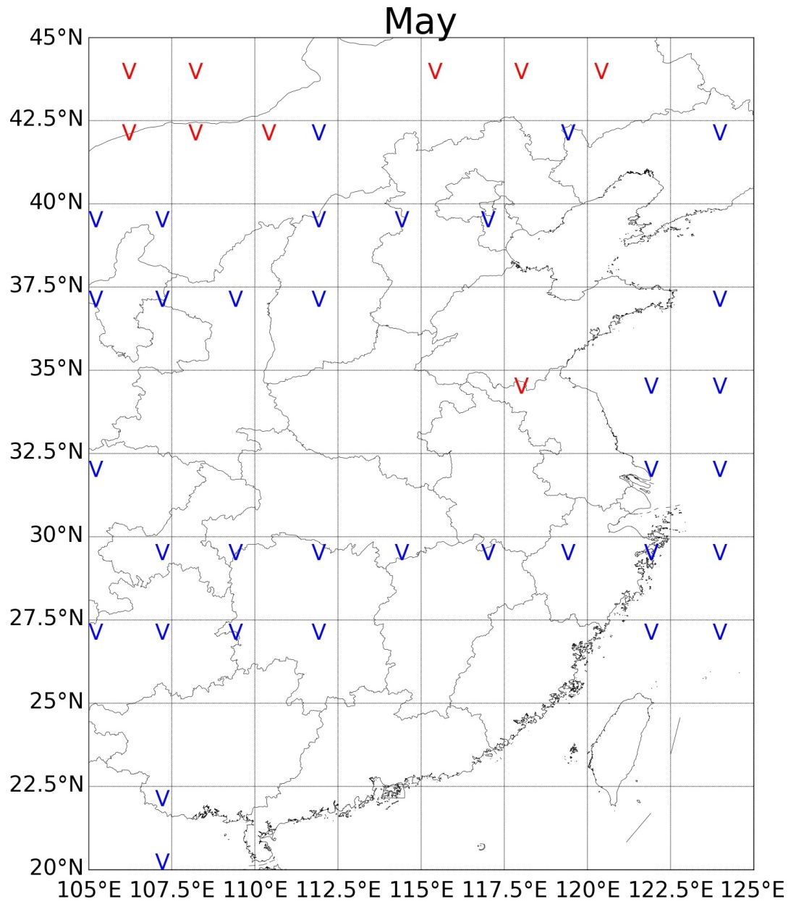
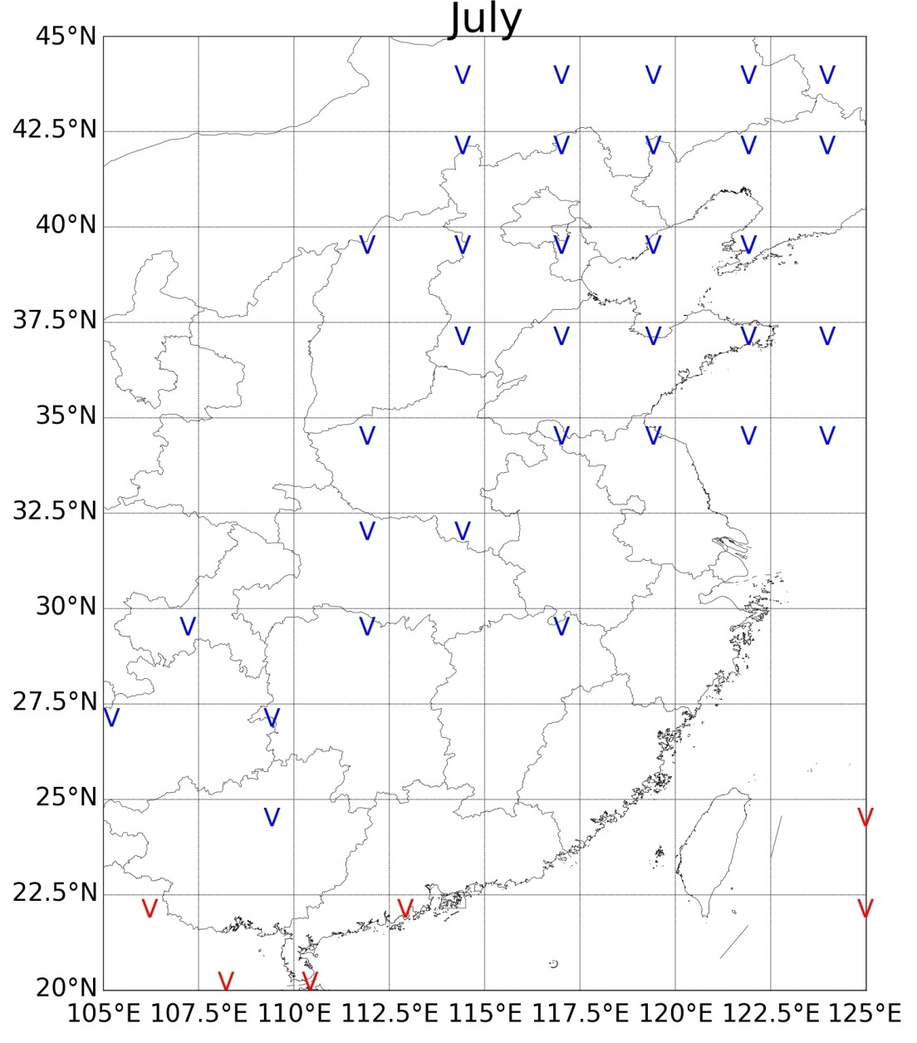
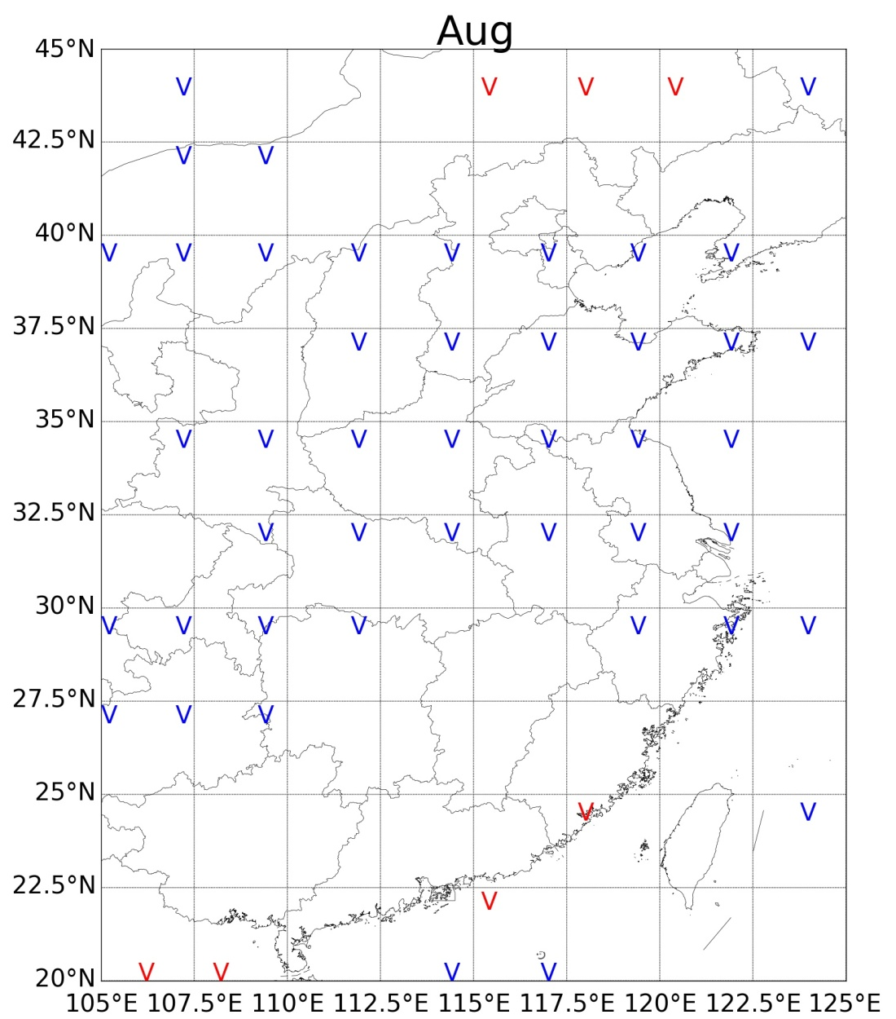
meridional wind component (V)
The meridional component of wind field is dominated by the humid southerly winds in summer. It broadly shows positive relationship with the CWV.
Notes:
Monsoon winds from southern Ocean bring water vpour into the EASM region. Therefore, the v-winds are basicly positively related to the vapour amount.

Slide 13
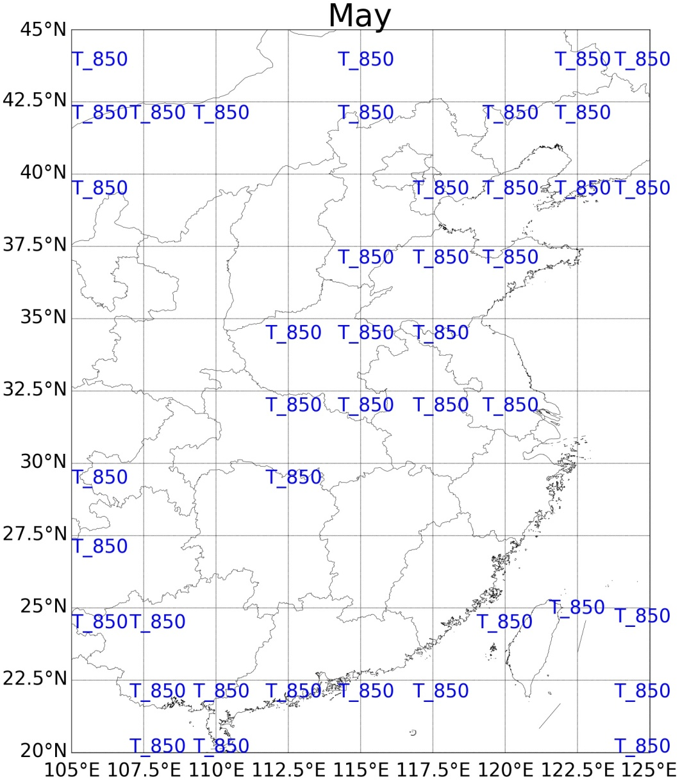
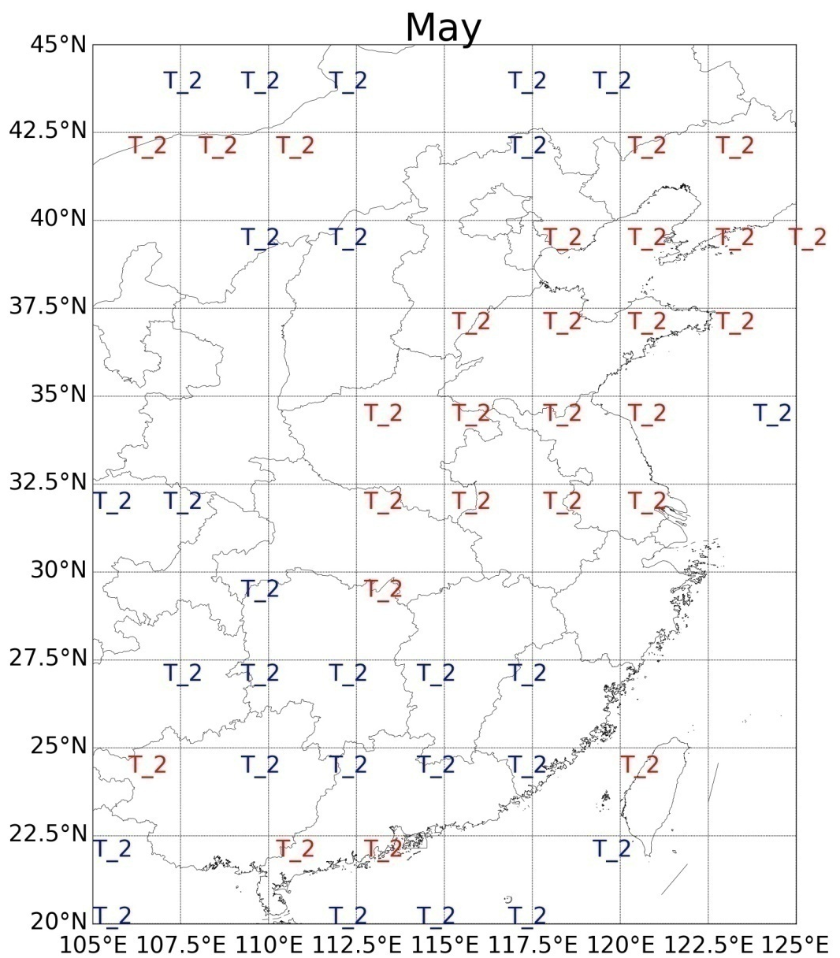
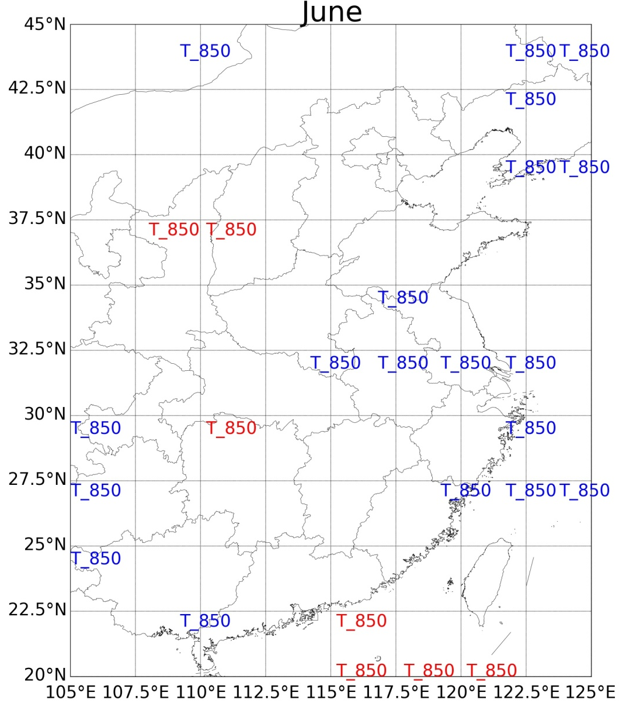
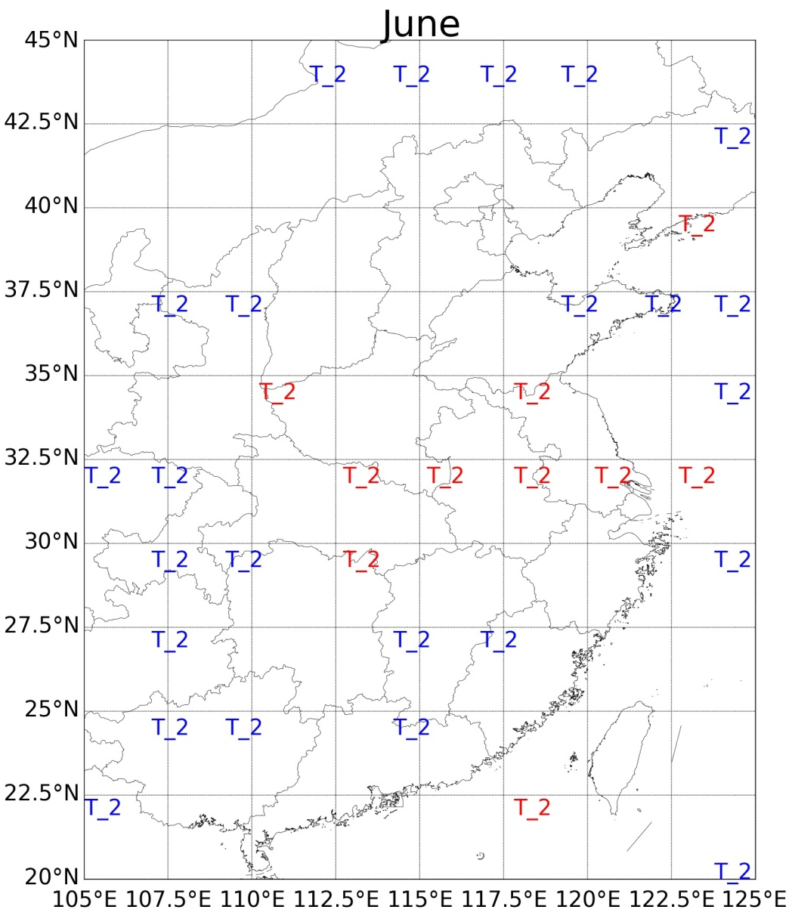
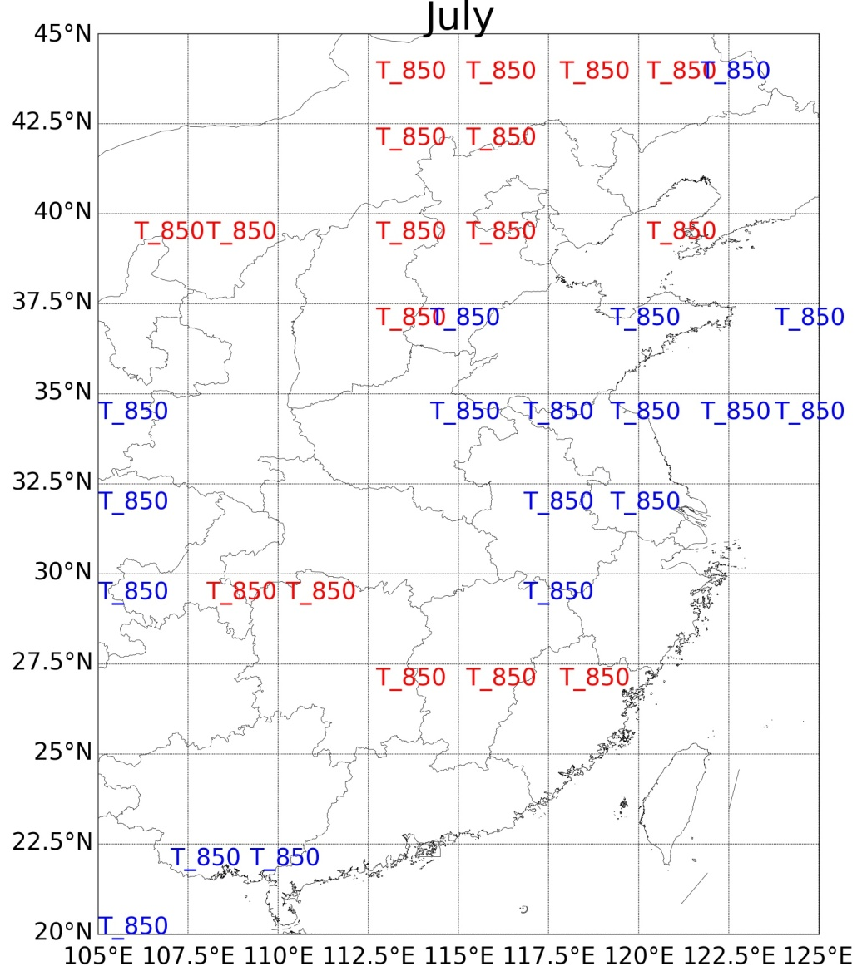
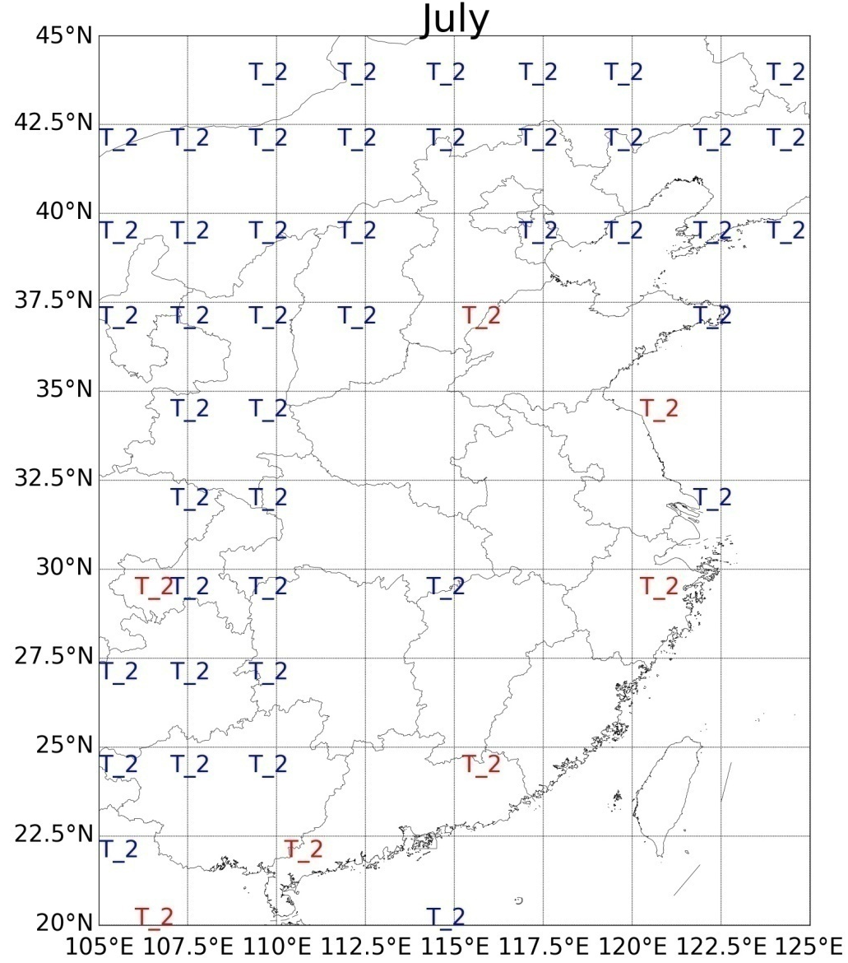
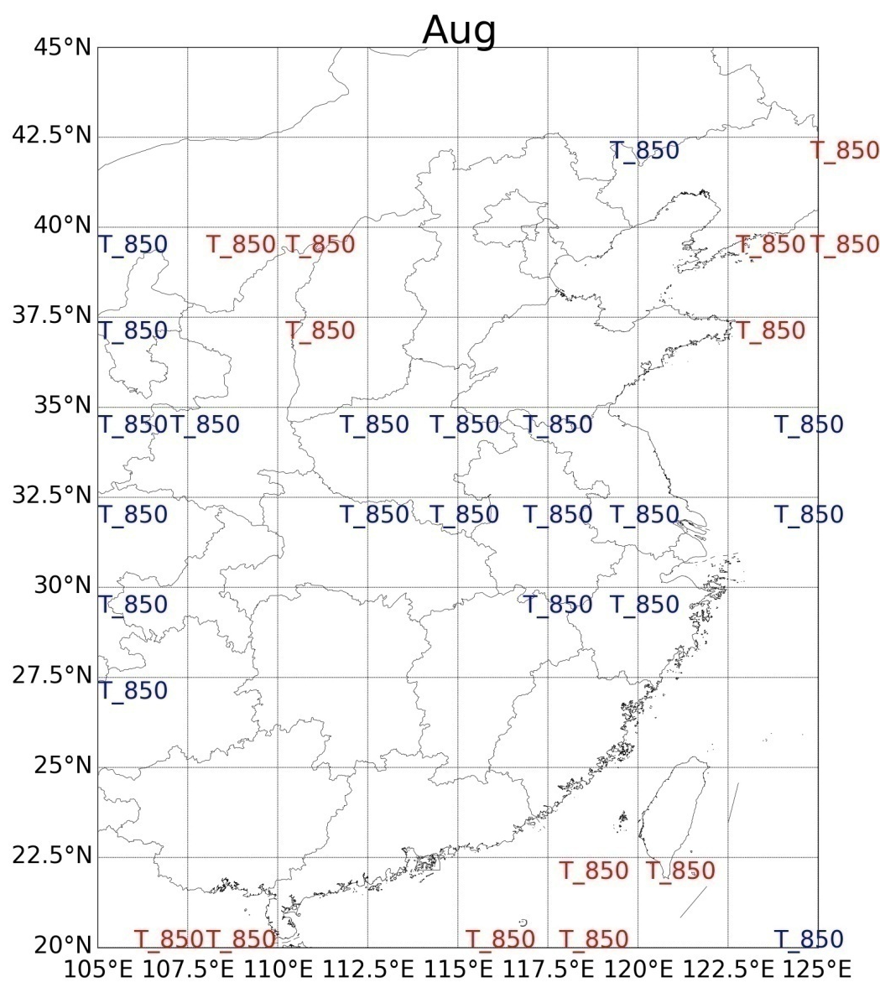
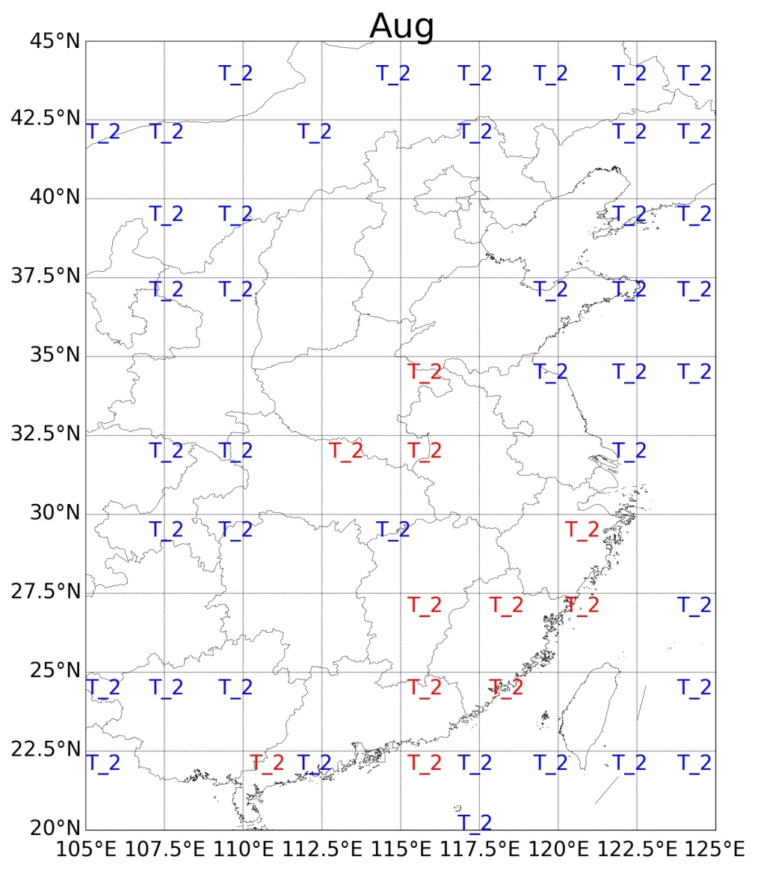
air temperature at
850 hPa(T_850)
2 meter temperature
(T_2)
On one hand, warmer air can hold more water vapour.
On the other hand, warm and moist air in the lower troposphere indicates high convective instability and high probability of rainfall.
Notes:
Because temperature is expected to be important, we consider both the 2 meter temperature (T_2) and the 850 hectopascal (hPa) air temperature (T_850).
It can be seen that temperature can affect the vapour content over broad areas of the EASM region. However, the sign of the influence can either be positive or negative for both T_2 and T_850.
Due to the Clausius-Clapeyron equation, it is easy to understand the positive influence from air temperature. For the negative influence, no such straightforward explanation exists.
A possible explanation can be from a thermodynamic perspective. The low-level air can either be dry or humid when the temperature is high. For the former case, the CWV will be relatively low. For the latter case, which indicates warm and moist air in the lower troposphere. In this case, the convective instability will be high and precipitation is likely to occur, drying out the air and ending up with lower CWV.
Therefore, low level air T can be negatively related to the amount of water vapour.

Slide 14
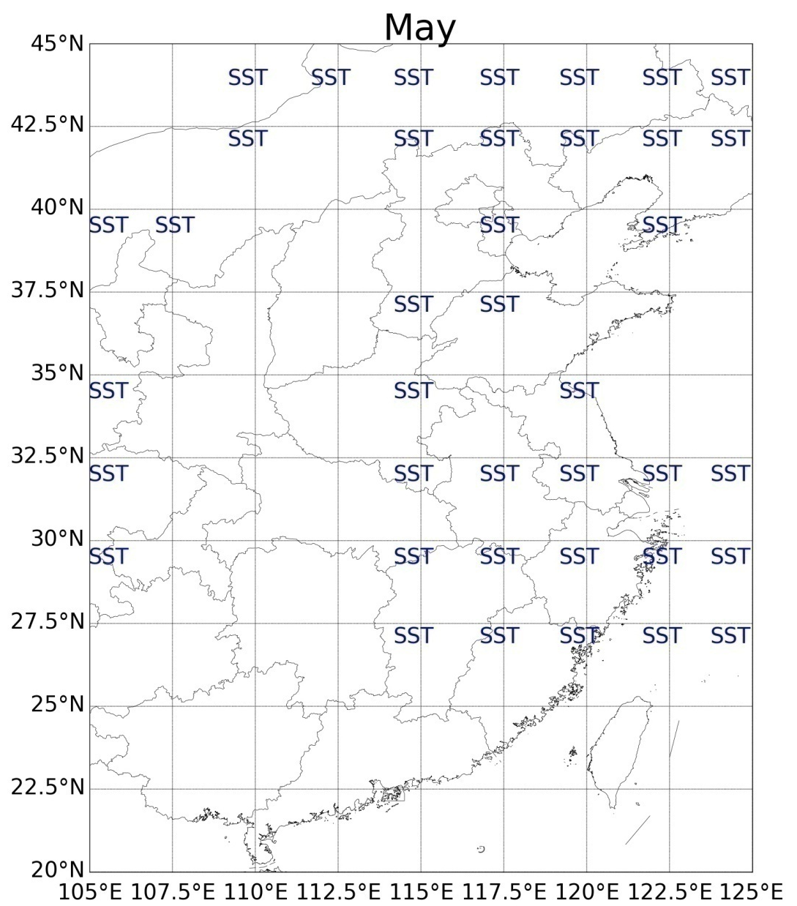
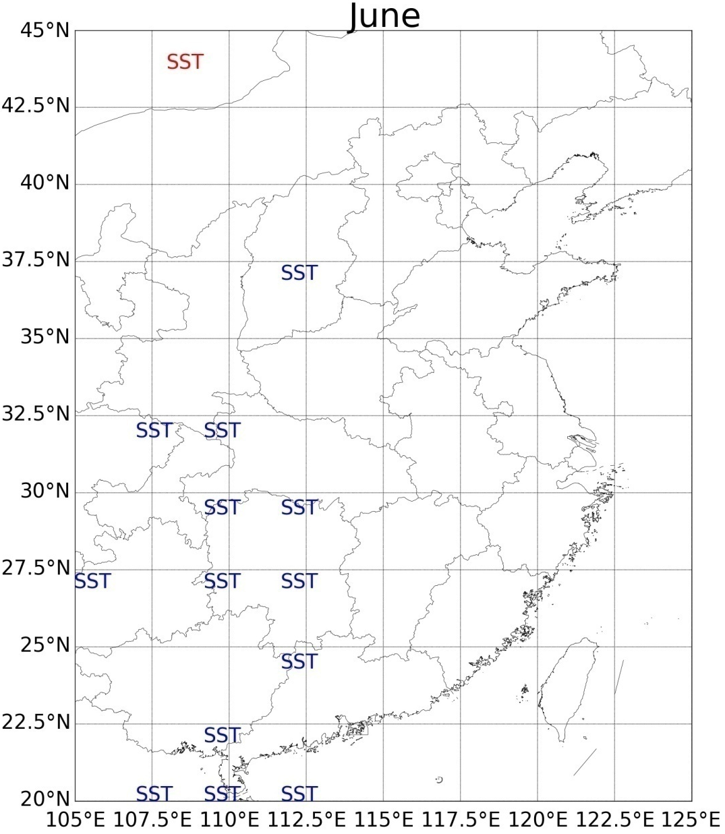
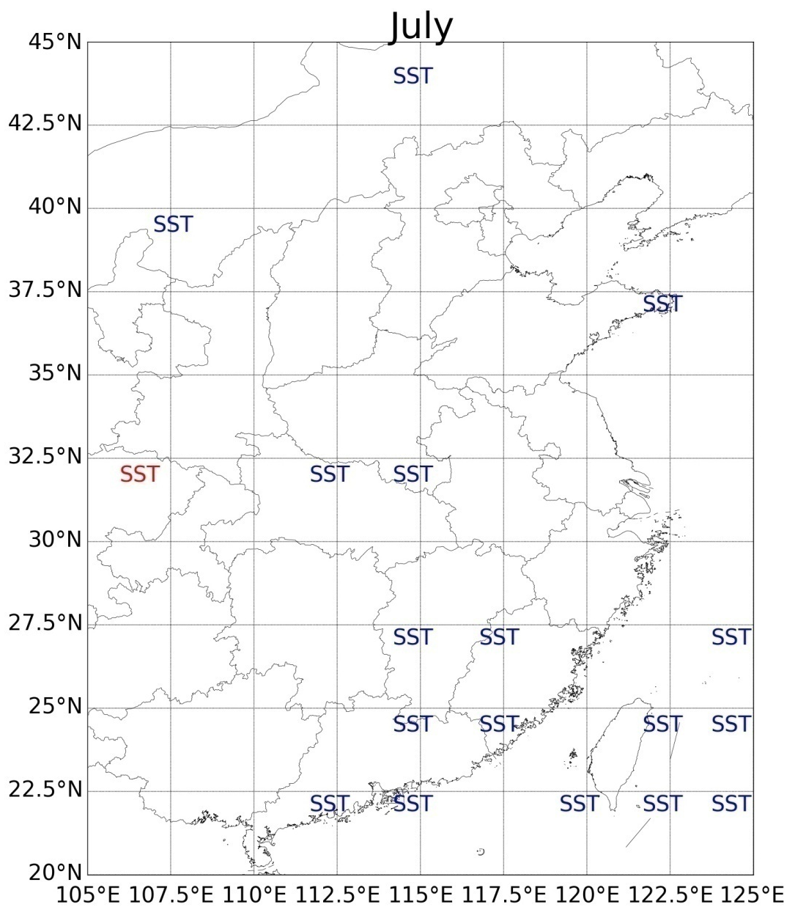
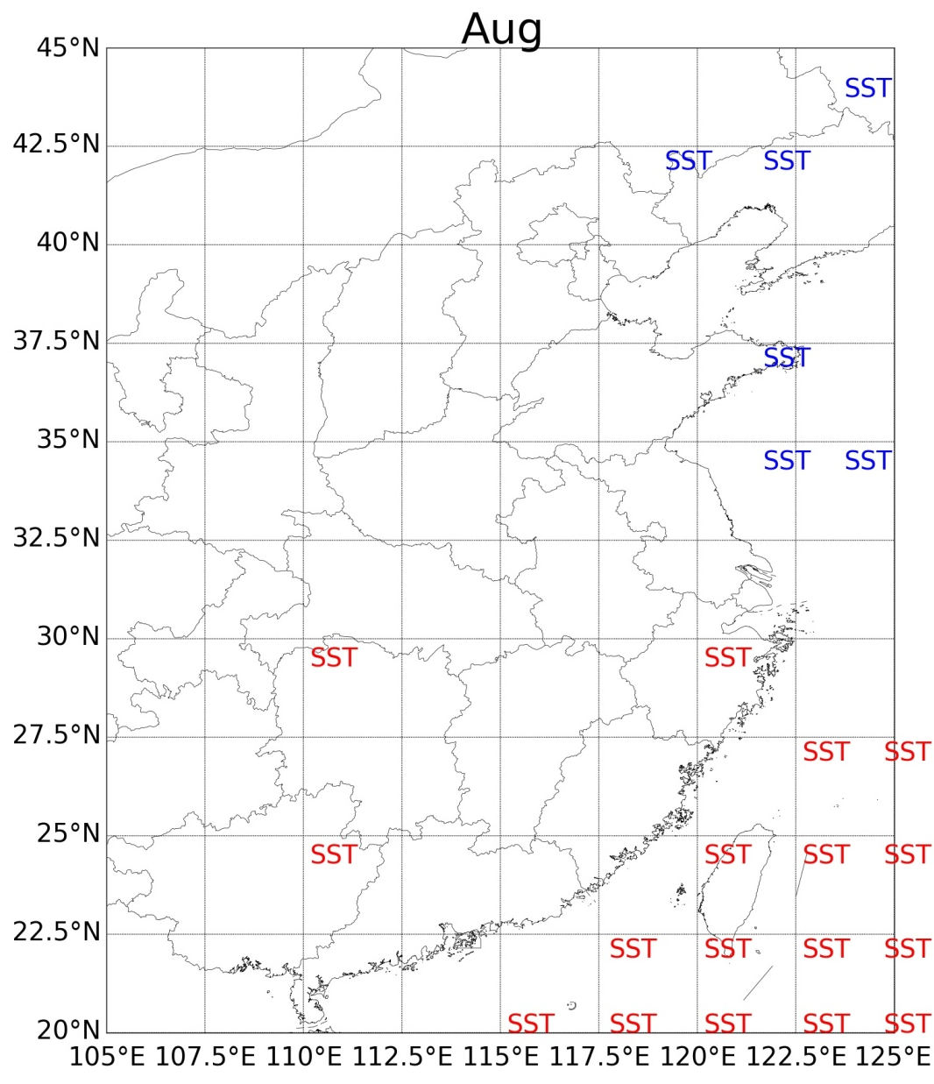
sea surface temperature (SST)
Higher SST of Bay of Bangel can lead to higher evaporation from the sea surface and more water vapour can be transported into the EASM region.
Notes:
The SST of the BoB is basically positively related to the CWV. Because higher SST means more evaporation and thus more water vapour can be transported into the EASM region.
In August, SST can also negatively related to the vapour amount.
It is not immediately clear why this happens. One explanation can be the potential interference of the CWV responses to summer SST anomalies in other oceans (Wen et al. 2015), the so-called ocean-atmosphere teleconnections.
However, isolating a specific ocean influence from the interrelated ocean forcing would introduce other terms of uncertainties. Importantly, it violates our "back to basics" principle, which will be discussed in section 5.

Slide 15
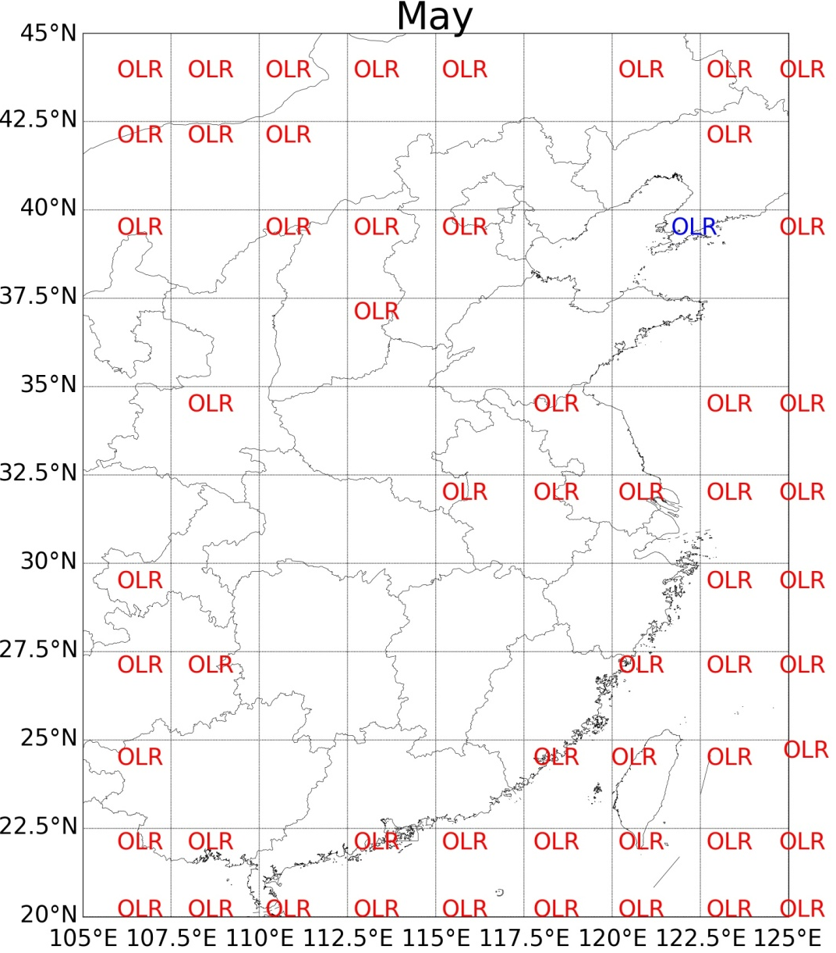
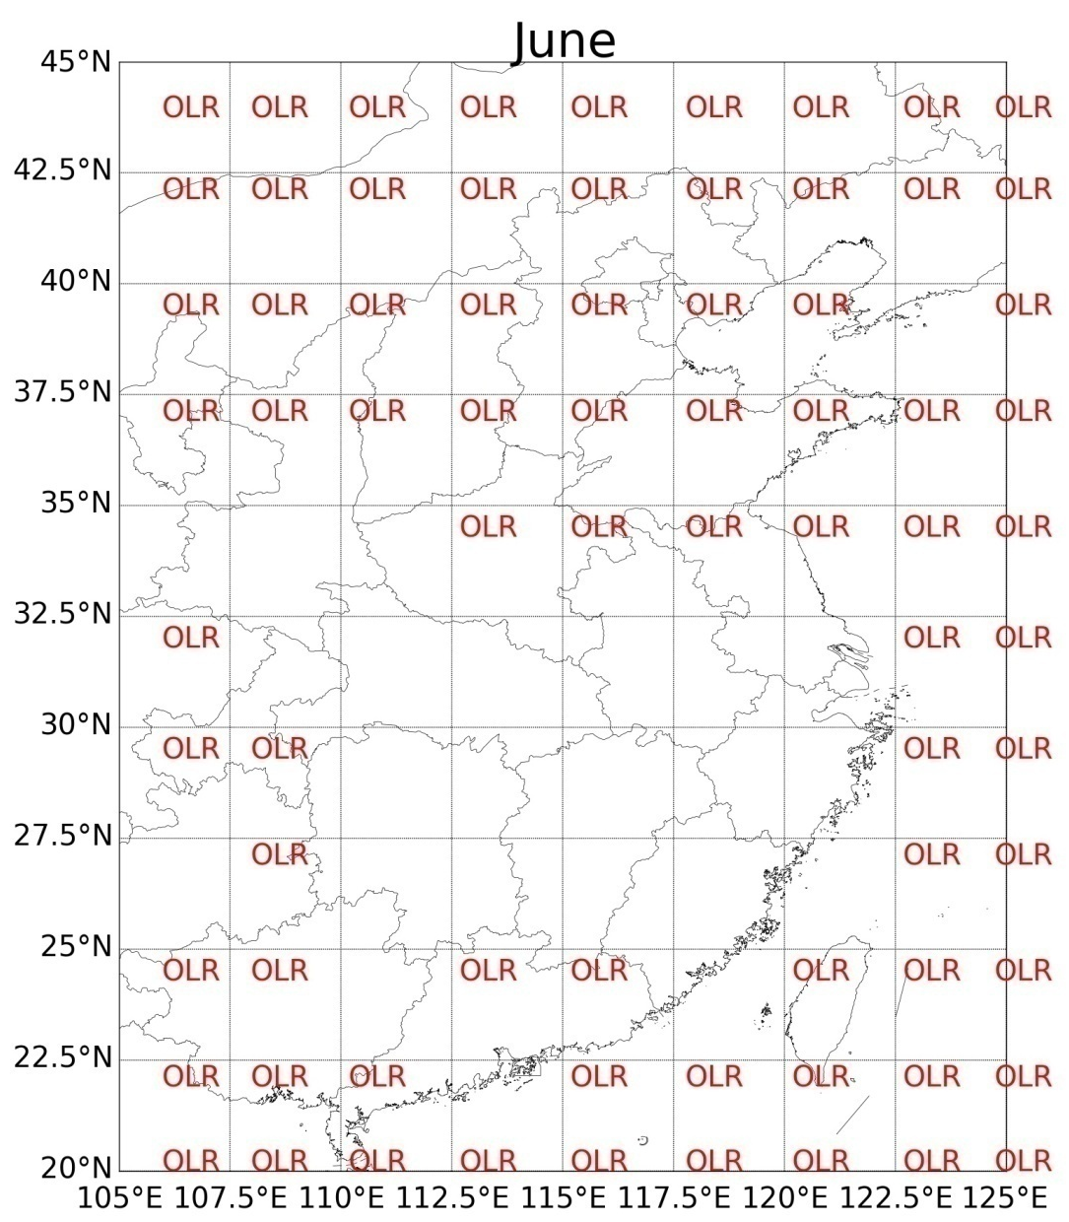
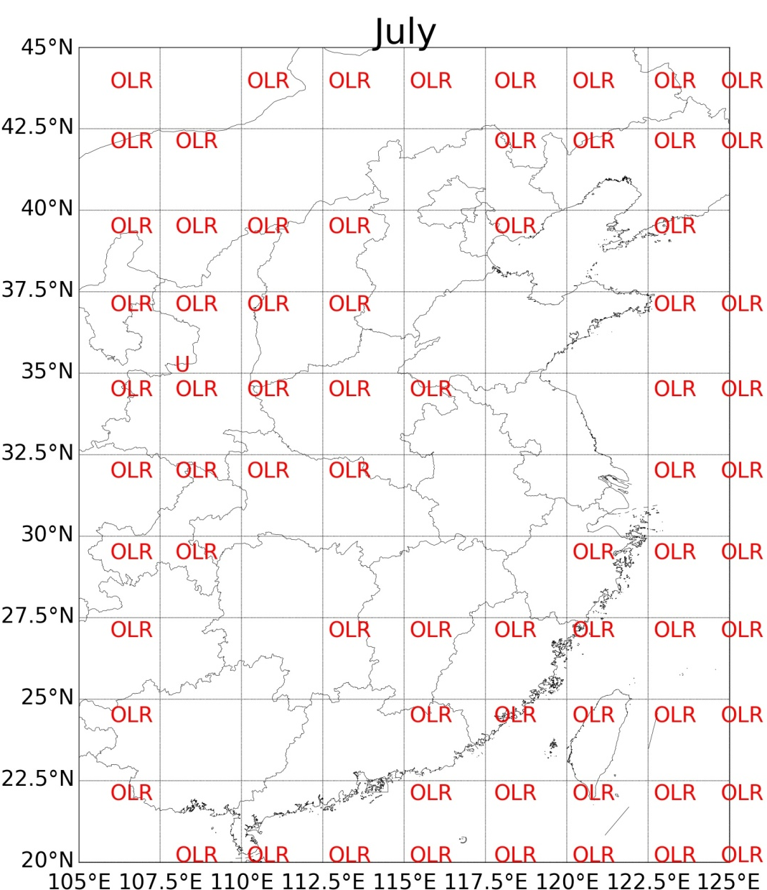
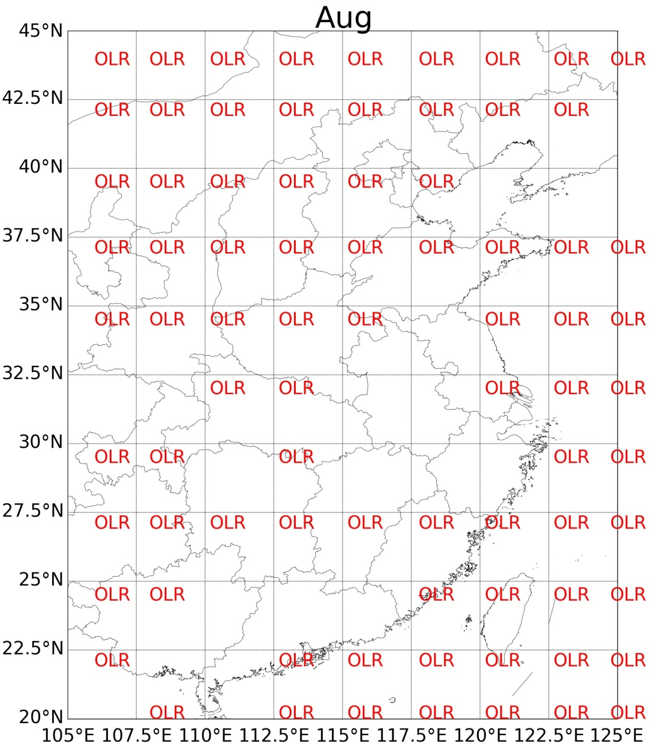
outgoing longwave radiation (OLR)
Negative OLR indicates enhanced convection and more water vapour condensating into liquid (cloud) water, which dries out the air.
Notes:
OLR is a indicator of the convective activity (Lim et al. 2013) . Negative OLR indicates enhanced convection and more water vapour condensating into liquid cloud water (Chaudhari et al. 2010; https://www.ncdc.noaa.gov/teleconnections/enso/indicators/olr/).
Our results agree with this understanding of OLR. It can be seen that OLR is generally negatively related to the CWV, indicating the removing effect of precipitation.

Slide 16
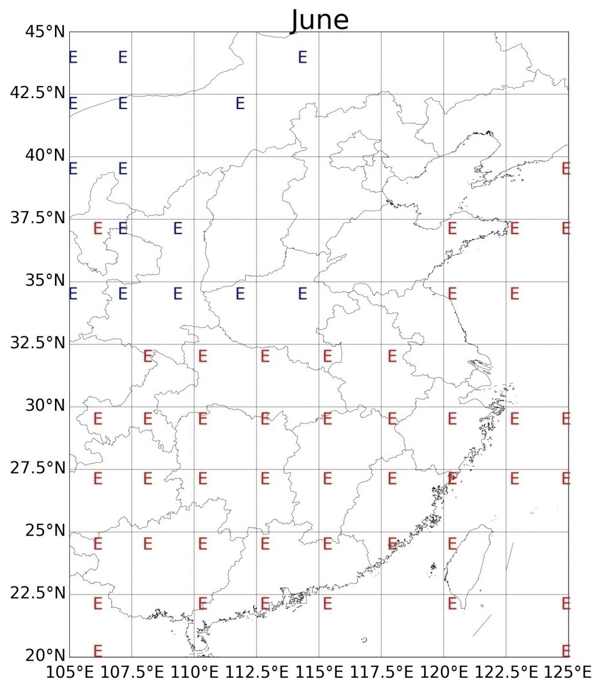
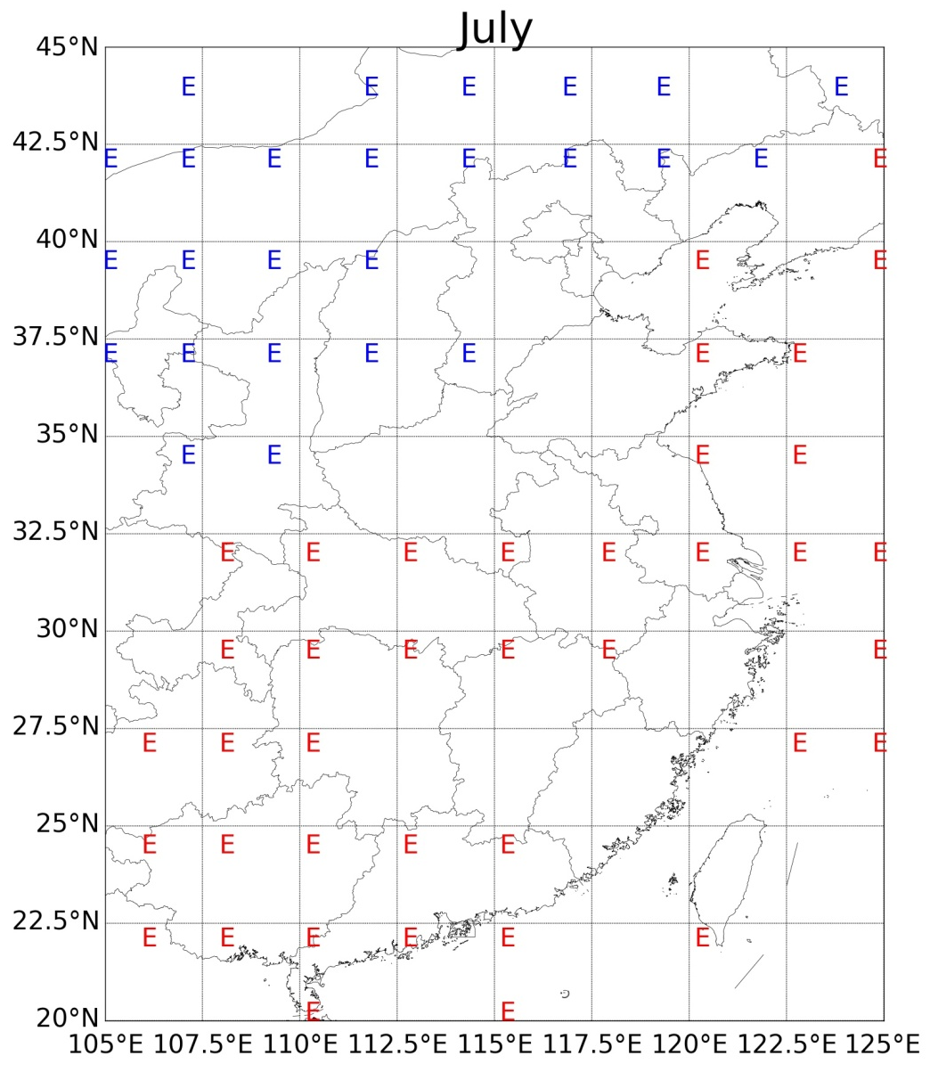
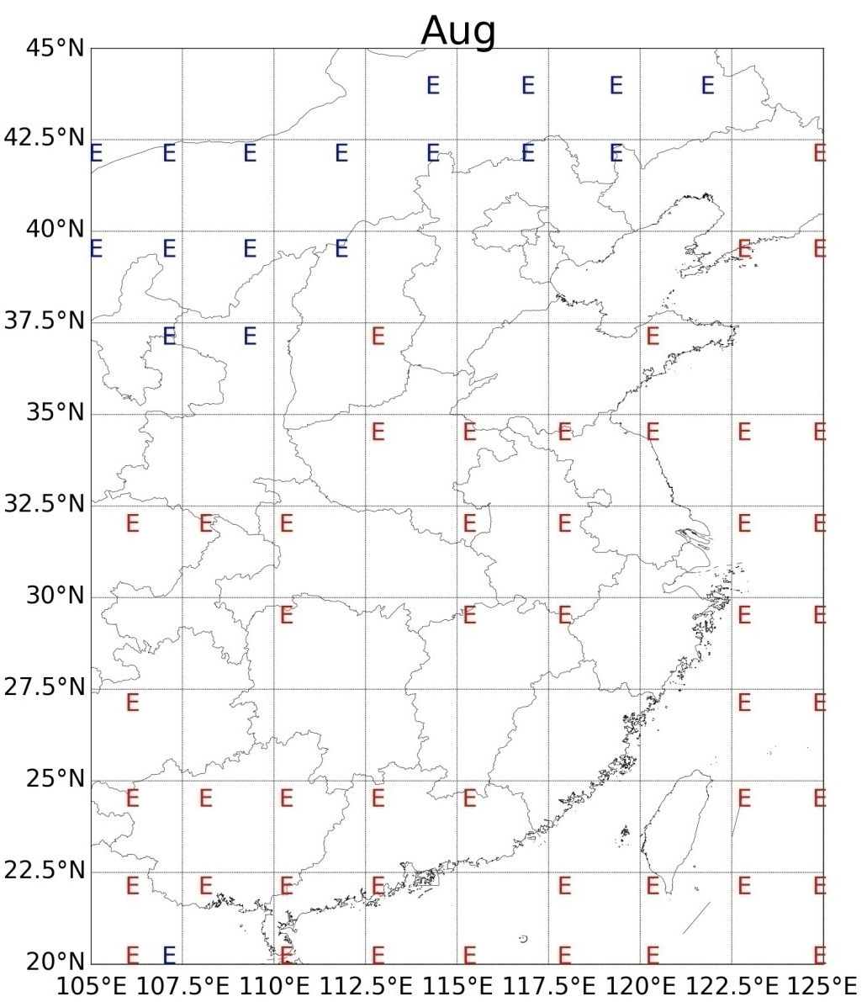
evaporation (E)
Evaporation moistens the air in arid and semiarid regions.
In the warm moist monsoon regions, high evaporation corresponds to the occurrence of rainfall.
Notes:
It is simple that evaporation can moisten the atmosphere. So E should be positively related to the CWV. However, in most part of the southern regions, evaporation has been detected as negatively related to the vapour amount.
Again, the convective precipitation can be used as a bridge. In the warm moist monsoon regions, high E happens with high surface T, high surface temperature leads to high probability of convective precipitation. In turn, precipitation moistens the land surface and increases the evaporation.
Therefore, from a statistical perspective, evaporation can positively related to precipitation and negatively related to the CWV.

Slide 17
Outline
Study aims
Data & methods
Relationship with various variables
Dominant climatic processes on CWV
Summary
Notes:
There are five parts in my talk.

Slide 18
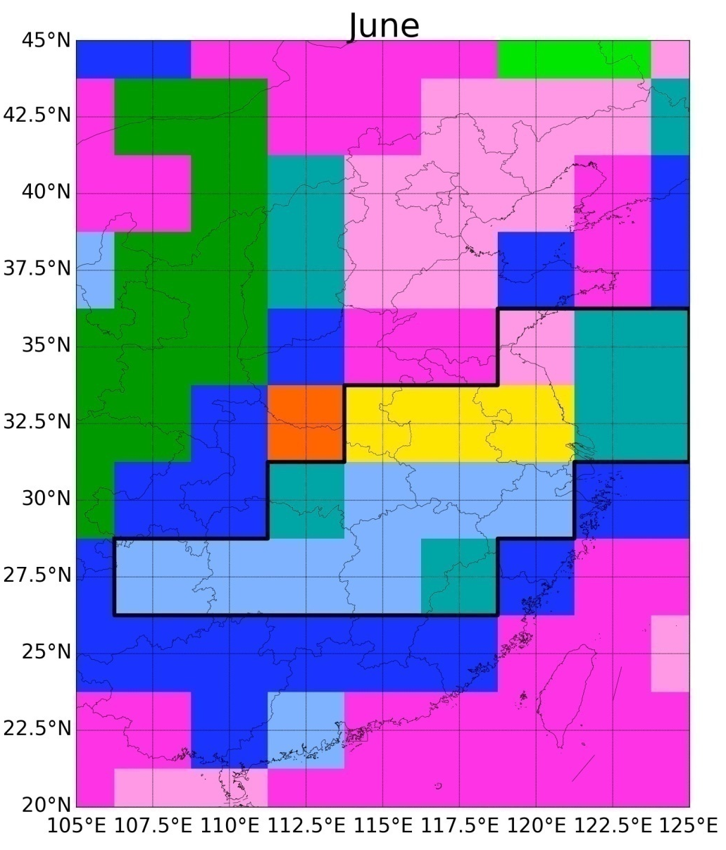
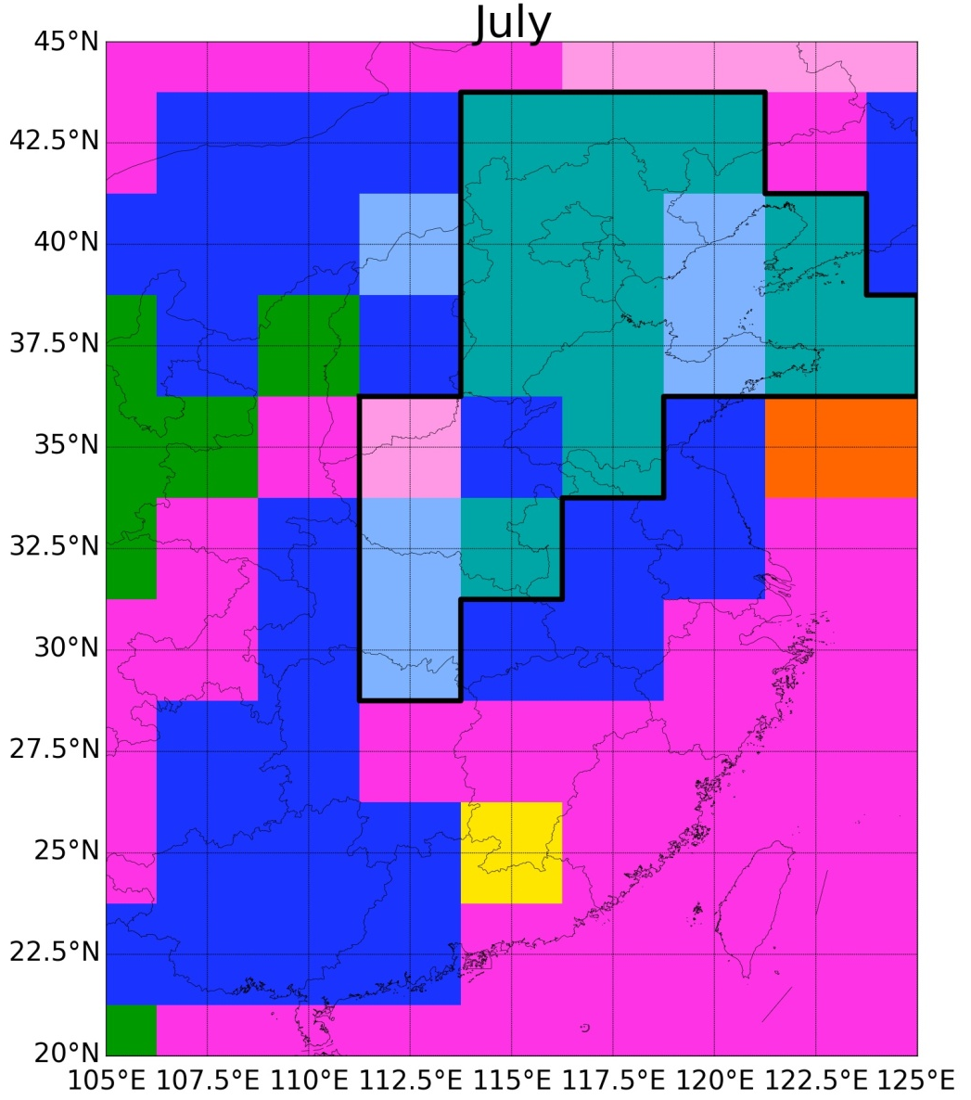
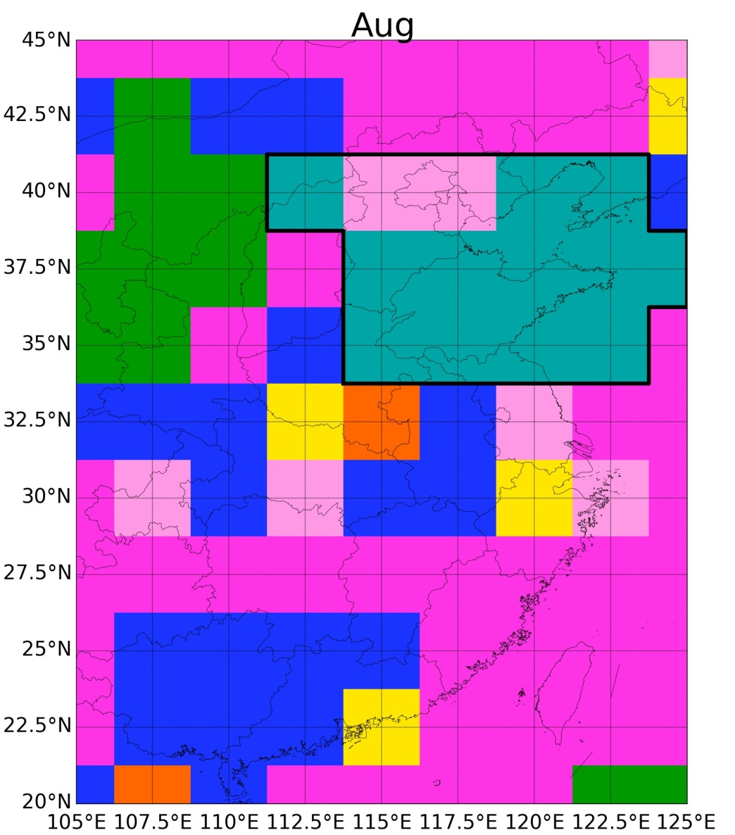
Dominant climatic processes on CWV
Monsoon-free regions : having little influence from the summer monsoon even during strong monsoon years.
Monsoon transition regions: water vapour content is mostly influenced by monsoon variation.
Monsoon controlled regions: covered by monsoon even in weak monsoon years.
Notes:
Climatic variables mostly related to CWV. Vwind has also been shown when it is the second most important . The bold lines indicate the approximate distribution of the monsoon-transition regions
The water vapour removing effect of the Westerlies, the drying out indicated either by OLR or by evaporation, and the moistening effect from evaporation or by monsoon show up as the primary drivers of the vapour content at various locations in different months.

Slide 19
Outline
Study aims
Data & methods
Relationship with various variables
Dominant climatic processes on CWV
Summary

Slide 20
Summary
The water vapour removing effect of the Westerlies, the drying out indicated either by OLR or by evaporation, and the moistening effect from evaporation or by monsoon show up as the primary drivers of the vapour content at various locations in different months.
Monsoon can be understood from the water vapour perspective.

Slide 21
Thank you !

Slide 22
Relationship with various variables
Notes:
These are results of the model selection.
The black contours are coefficients of multiple correlations (R). P-values equal or larger than 0.01 are shown as green contours (%).

