Slide 1
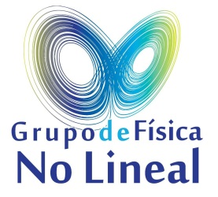
On the Origin of the moisture in Atmospheric Rivers
using a WRF tracers tool
Jorge Eiras-Barca¹, Huancui Hu², Daniel Garaboa-Paz¹, Francina Dominguez²
and Gonzalo Miguez-Macho².
1 - Non-linear Physics Group, University of Santiago de Compostela, Spain.
2 - Department of Atmospheric Sciences, UIUC, Il, USA.

Slide 8
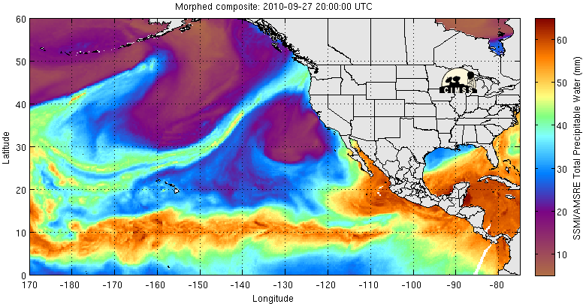
0. Introduction
0. Introduction
ATMOSPHERIC RIVERS (ARs) are defined in the literature as long and narrow structures of high water vapor content column and integrated vapor transport (water vapor flux).
AR in the Precipitable Water Field
WCB
Atmospheric River
Tropical Moisture Exports

Slide 9
0. Introduction
First identified by NEWELL AND ZHU in 1992, ARs are observed to commonly come along with some extratopical cyclones, on their warm region and “feeding” the Warm Conveyor Belt with moisture.
WCB
Atmospheric River
Tropical Moisture Exports

Slide 10
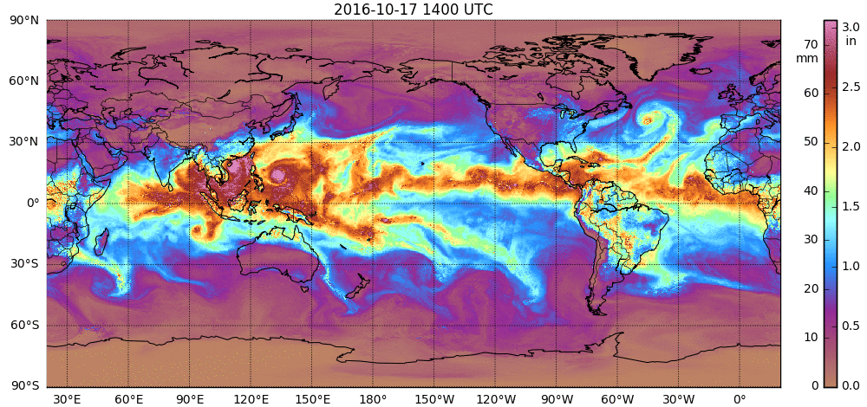
0. Introduction
Between 3 and 5 ARs can be found at any time per hemisphere.
The “strength” of the AR depends on multiple factors, such as the continentality, seasonality, synoptic development of the cyclone, etc.
1
3
2
7
4
5
6
8
Source : CIMSS/MIMIC-TPW Ver.2

Slide 11
The relevance of the ARs is twofold: CLIMATIC and METEOROLOGICAL.
From the CLIMATIC point of view; ARs are responsible for about 90% of the poleward flux of moisture and latent heat transport in midlatitudes.
The atmosphere is the principal contributor to the poleward transport of energy in the climate system. Thus, ARs a key factor in the thermal and energetic balance of the planet.
0. Introduction
1
3
2
7
4
5
6
8

Slide 12
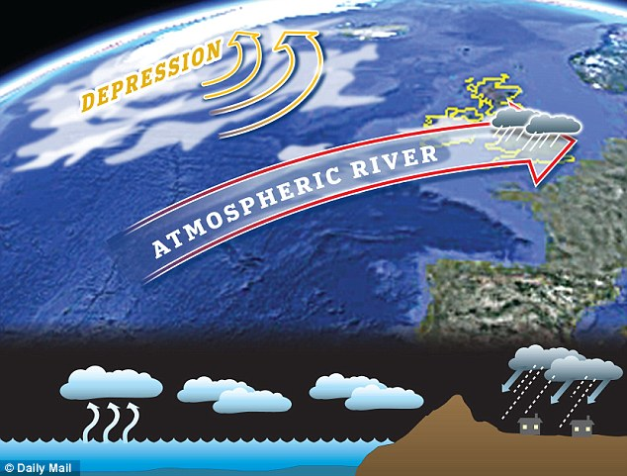
0. Introduction
From the meteorological point of view, ARs are closely related to extreme precipitation and floods in many parts of the world. This point has been studied extensively in the Northern Hemisphere.
Image Source: Daily Mail

Slide 13
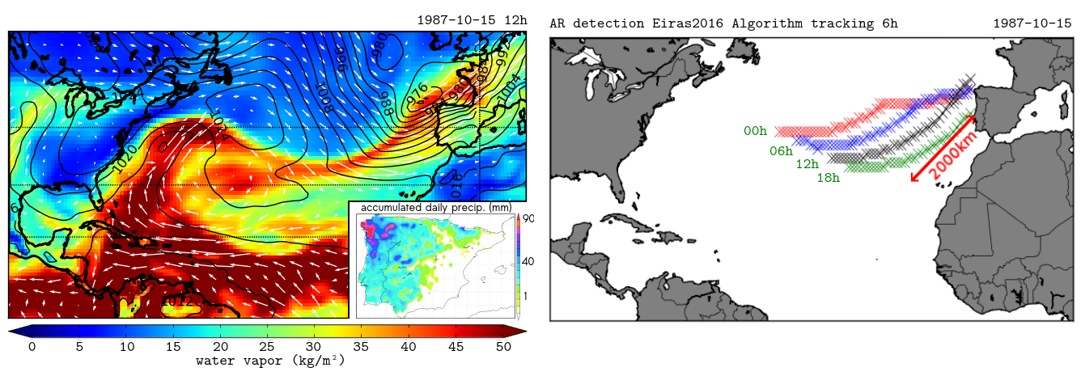
0. Introduction
Regarding the detection and identification of ARs, different algorithms have been published in the last few years. These algorithms are commonly based in the properties of the WATER VAPOR and WIND fields, and other criteria related to the shape and coherence of the AR.
E.g. Lavers et al. (2011), Guan et al. (2015), Eiras-Barca et al. (2016), and Brands et al. (2016)
Example of Detection:
Example of the 24h evolution of central axis of the AR detected by EIRAS2016 algorithm.

Slide 14
1. Origin of the Moisture
However, the source of moisture in AR events is still debatable.
While some studies suggest that the LOCAL CONVERGENCE is the primary source of moisture for ARs…
e.g.: Bao et al. (2006), Dacre et al. (2014)
WCB
Atmospheric River
Tropical Moisture Exports

Slide 15
1. Origin of the Moisture
Most of them point out to Tropical Moisture Export (TME) as the
most important source of moisture…
e.g.: Knippertz and Wernli (2010), Sodemann and Stohl (2013), Ryoo et al. (2015), Ramos et al. (2015).
WCB
Atmospheric River
Tropical Moisture Exports

Slide 16
1. Origin of the Moisture
We think that today, there is a good agreement in the fact that BOTH sources are important.
WCB
Atmospheric River

Slide 17
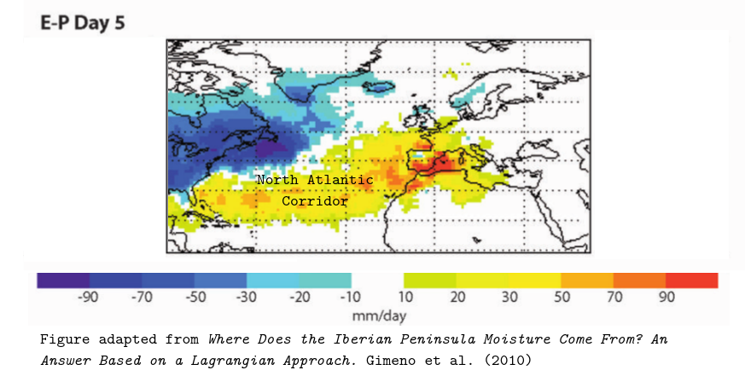
1. Origin of the Moisture
Lagrangian climatic tools have been used to identify the OCEANIC
CORRIDORS as the main source of humidity for midlatitudes.
These corridors connect the tropics with higher latitudes. For instance, the NORTH ATLANTIC CORRIDOR has been shown to be
the most important source of precipitation for the Iberian Peninsula (Gimeno et al., 2010; Ramos et al. 2016).

Slide 18
2. Methods
2. Methods
A WRF-tracer tool has been recently implemented by Prof. Gonzalo Miguez-Macho and has been used in different studies.
The tracers tag the humidity contained in a given mask (given region), and follow this humidity throughout the entire domain of simulation in a EULERIAN FRAMEWORK.
Unlike previous water vapor tracking algorithms used in WRF, we follow the moisture that originates in a 3D domain.
The numerical active tracers behave in the same way as water vapor. They experience convection, turbulence, phase change, etc.
Our objective in this study is to present the tool and to prove its value in the analysis of the origin of the moisture for specific AR events.

Slide 19
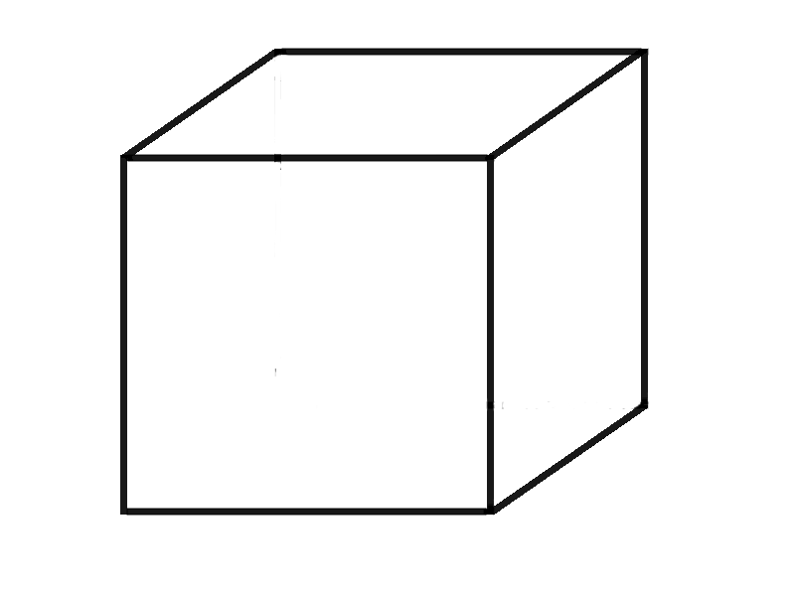
The 3D WRF-Tracer tool
2. Methods
δq_{WRF}
δq_{WRF}
t=0 -> $\vec{q}(\vec{r},0)={\vec{q}}_{0}(\vec{r},0)$
At time=0, we have information from the INITIAL CONDITIONS only. $\vec{q}o$ -> WATER content.
t=T -> $\vec{q}WRF \left(\vec{r},T\right)={\vec{q}}_{0}\left(\vec{r},0\right)+\sum_{i=1}^{T}{∆q\text{WRF} }$
t=T -> $\vec{q}TRA \left(\vec{r},T\right)=0 +\sum_{i=1}^{T}{∆q\text{TRA} }$
Grid-Cell X,Y,Z
δq_{WRF}
δq_{WRF}
q (r,t=0)
δq_{WRF}
δq_{WRF}
Advection
q_{vapor,}q_{rain},q_{ice},…
CONVECTION+TURBU- LENCE+PHASE CHANGE
In the subsequent time-steps, the cell will lose and gain water flux interacting with its close neighbours.
The Tracers replicate this method, but only the moisture previosly LABELED in a DISTANT REGION MASK will be considered in the fluxes.
δq_{WRF}
δq_{WRF}

Slide 20
2. Methods
t=T -> $\vec{q}WRF \left(\vec{r},T\right)={\vec{q}}_{0}\left(\vec{r},0\right)+\sum_{i=1}^{T}{∆q\text{WRF} }$
t=T -> $\vec{q}WRF TRACERS \left(\vec{r},T\right)=0 +\sum_{i=1}^{T}{∆q\text{TRA} }$
We can label the tropical regions only.
The “usual” $\vec{q}WRF \left(\vec{r},T\right)$ and the “tracers” $\vec{q}WRF TRACERS \left(\vec{r},T\right)$ are NOT going to interact between each other; i.e. when compared we are going to know the ratio of tropical water out of the total, in each grid cell.

Slide 21
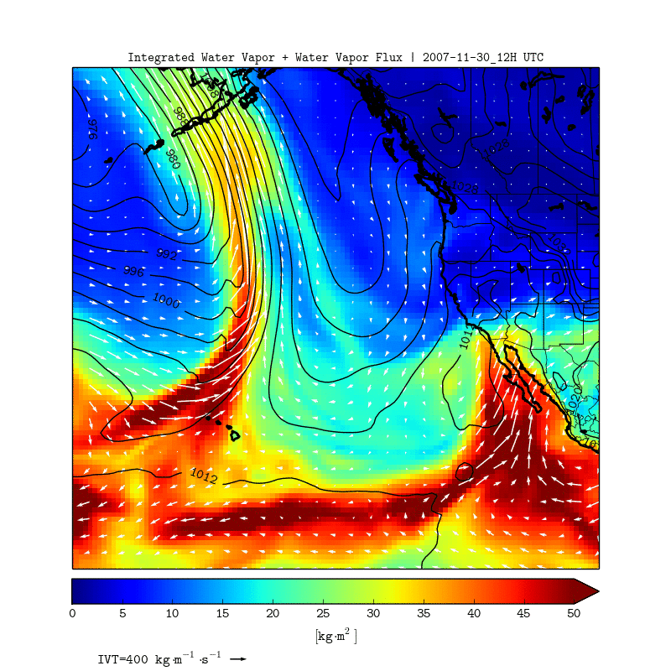
2. Methods
Presentation Example: The “Great
Coast Gale of 2007”
US West Coast

Slide 22
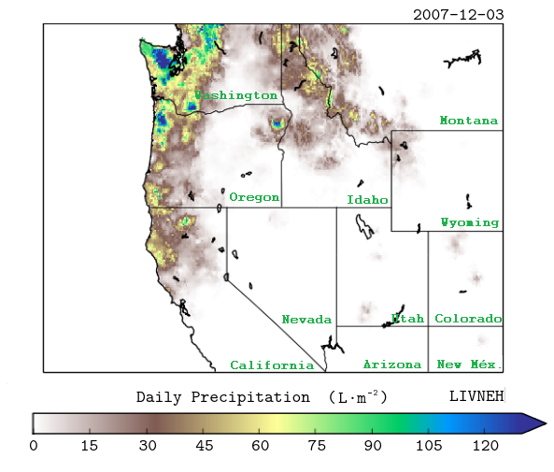
2. Methods
The event caused 24h accumulated precipitations over 120 mm measured in different points of the states of Washington St. and Oregon.
The selected event caused EXTREMELY PRECIPITATION AND STREAMFLOW throughout the region.

Slide 23
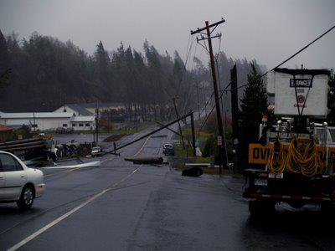
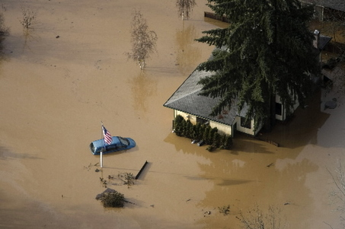
2. Methods
About $1 Billion in direct and indirect costs. (Avelino and Dall’erba, 2016).
Hurricane Force Winds.
18 FATALITIES.
Hundreds of people evacuated by the US Coast Guard and US National Guard.

Slide 24
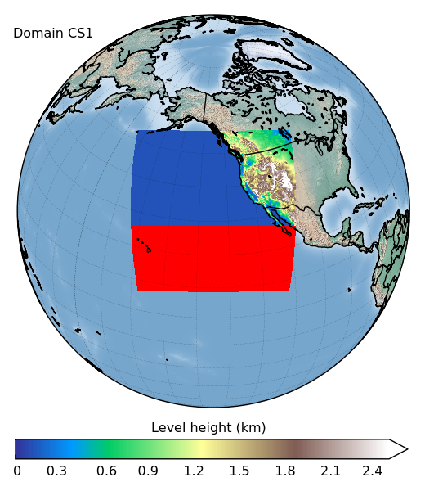
2. Methods
Domain of Simulation
3D Tracers Mask
We are able to “follow” the moisture which originally lies in tropical regions and its ASSOCIATED
PRECIPITATION.
We are able to know the ratio of mid-latitude precipitation(given by the simulation) that came directly from tropical evaporation.

Slide 25
Results
WRF Simulation: – ESPECIFIC HUMIDITY (NO TRACERS).
3. Results

Slide 26
WRF Simulation: – Tracers SPECIFIC HUMIDITY.
3. Results
The simulation starts 8 days before the landfall event

Slide 27
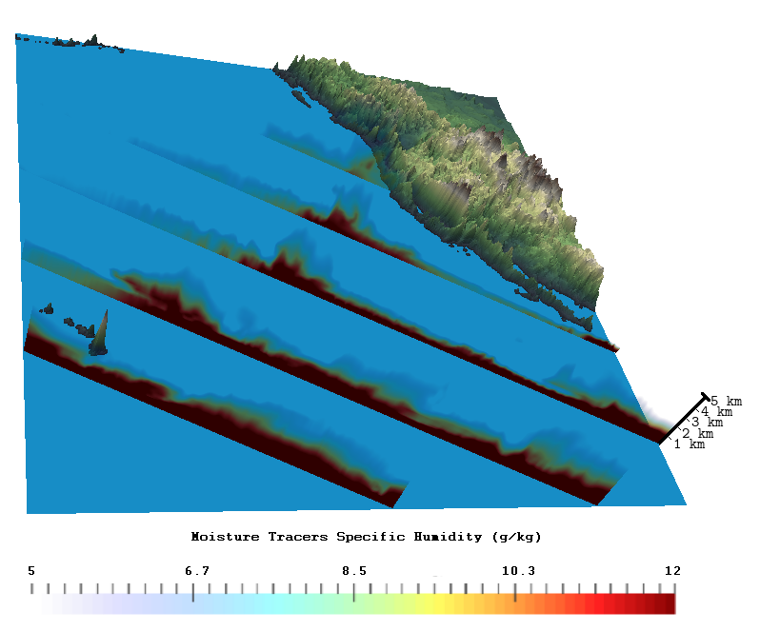
3. Results
The vertical distribution of the TROPICAL moisture can be analyzed
throughout the transversal cross sections.
Landfall event 2007/12/03
Most of the tropical
moisture is advected in the warm sector of the cyclone.
The cold sector of the cyclone
is likely reserved for
the locally evaporated moisture.
central axis
Vertical Scale
As expected,
most of the tropical moisture remains in the first 3 km of the troposphere.

Slide 28
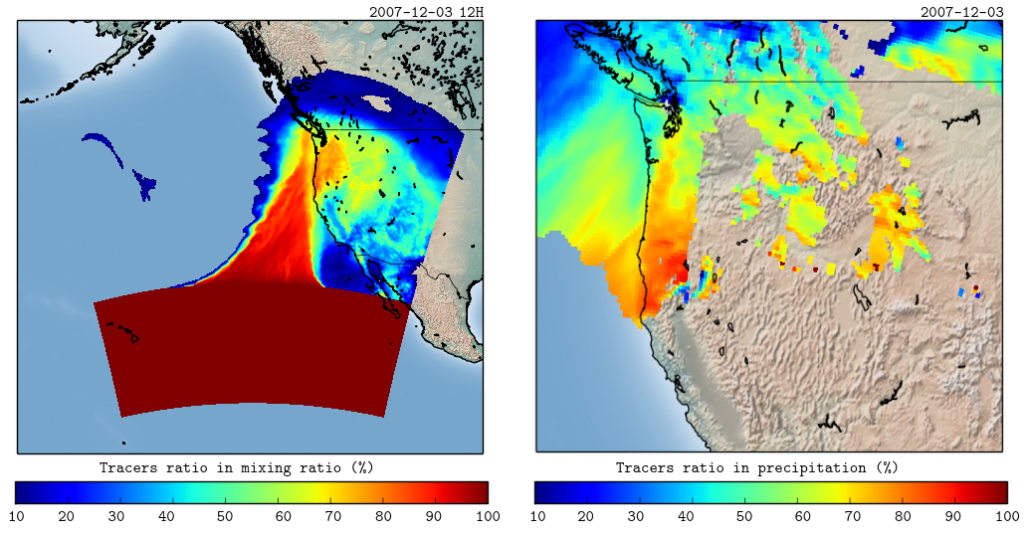
3. Results
We can easily analyze the ratio of tropical moisture and 24-h
accumulated precipitation out of the total.
moisture: precipitation:
The “Tropical Ratio” generaly exceeds the 70% in Both Cases, with values of 90% in some points.

Slide 29
Conclusions:
1- Using the new WRF-Tracer tool, In the “Great Coast Gale”
event, more than 70% of the moisture and precipitation have a tropical origin.
2- Through the development of the AR event, tropical moisture mostly stayed in the warm sector of the cyclone.
3- The new WRF-Tracer tool can be used to analyze not only the development of the cyclone, but the origin of the moisture in specific events as well.

Slide 30
Discussion:
Not all the ARs have a clear connection to the tropics, thus, the tropical moisture exports are clearly not going to be the primary source of moisture for all events. HOWEVER, based on these results we HYPOTHESIZE that the highest amounts of precipitable water can only be attained by a system with a clear tropical source of moisture.
This point is going to be further investigated.

Slide 31
Further Work:
1- More simulations are being prepared in order to get general ratios of “tropical influence” from a time and space-dependent point of view.
2- Different synoptic conditions or weather types are going to be considered in the next simulations.
3- Isotopes in precipitation can validate the WRF-Tracers.
(-) Any help or collaboration would be very well appreciated !!!

Slide 32
Thank You!
Jorge Eiras-Barca (Spain) – jorge.eiras@usc.es
Huancui Hu (China/USA) – hhu18@illinois.edu
Daniel Garaboa-Paz (Spain) – angeldaniel.garaboa@usc.es
Francina Dominguez (USA) - francina@illinois.edu
Gonzalo Miguez-Macho (Spain) – gonzalo.miguez@usc.es

