Slide 1


Extreme Hot Events Associated to Drought Occurrence
over the Southwest Mediterranean
A. Russo, C.M. Gouveia, A.M. Ramos, P. Páscoa, R.M. Trigo
8th EGU Leonardo Conference
Ourense, 24-26 October 2016
Notes:
1
1

Slide 2
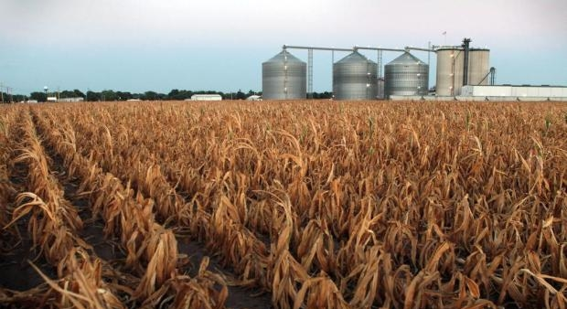
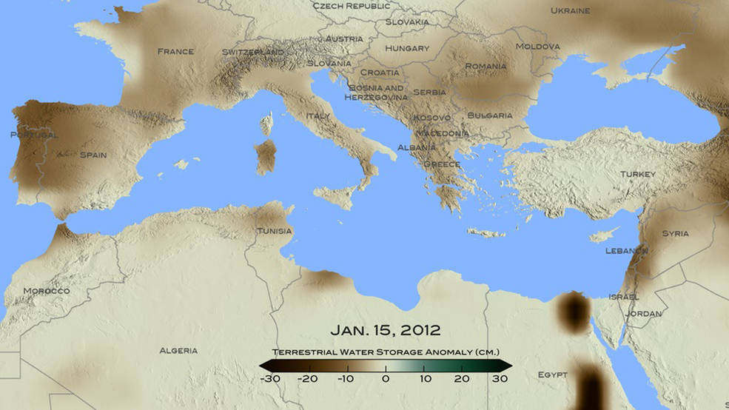
MOTIVATION
The Mediterranean is often affected by drought events with strong influence in ecosystems and the related social and economic impacts (e.g. Iberia 2005, 2012)
The water storage has diminished and the severity of droughts has increased due to the higher atmospheric evaporative demand
Europe has experienced multiple and unprecedented mega heat waves (e.g. 2003, 2010)
As global warming increases, the likelihood of hot extremes also rises, including further large-droughts and mega-heatwaves
Data from the GRACE satellites
Credits: NASA/ Goddard Scientific Visualization Studio
2003
2010
Bastos et al., 2014

Slide 3

OBJECTIVE
This work main goal is to assess if hot extremes in the Mediterranean region are preceded by moisture deficits
DROUGHTS
HOT EXTREMES
CLIMATE CHANGE

Slide 4
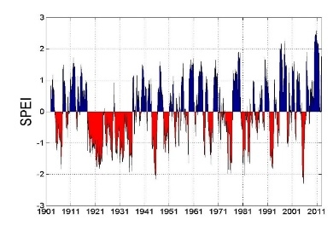
DROUGHT INDICATORS
SPI and SPEI
Standardized index that allows inter-seasonal comparison, allowing for the determination of the duration, magnitude and intensity of drought
Is a multi-scalar index
SPEI includes the effect of evapotranspiration, being more sensitive to global warming
SPEI | Drought classification
<1.65 | Extremely humid
1.28 a 1.64 | Highly humid
0.84 a 1.27 | Moderately humid
-0.84 a 0.84 | Normal
-1.28 a -0.83 | Moderately dry
-1.65 a -1.27 | Highly dry
< -1.65 | Extremely dry

Slide 5
EXTREME HEAT
NHN and NHD
Several definitions of hot extreme events
(e.g. threshold-based indices, percentile-based)
As opposed to threshold-based indices, percentile-based indices are more comparable across different climatic regions.
NHD and NHN: number of hot days/nights per month as the number of days with a maximum/minimum temperature exceeding the 90th percentile (TX90p and TN90p)
RClimDex package (Zhang et al., 2015): Quality control of the data, Bootstrap procedure for the estimation of exceedance rate for the base period.

Slide 6

DATA and METHOD
SPI and SPEI
NHD and NHN
CRU TS3.23 monthly data (0.5° x 0.5 °)
1950-2014
Different time scales (3,6,9)
Evapotranspiration (Penman-Monteith)
Month preceding the hottest month of each year
Proxy for surface moisture deficits
to assess the impact of DROUGHT on the occurrence of subsequent HOT DAYS in the respective hottest month of each year
ECAD-EOBS daily data (0.5° x 0.5 °) (Version 13)
1950-2014
Monthly NHD and NHN

Slide 7
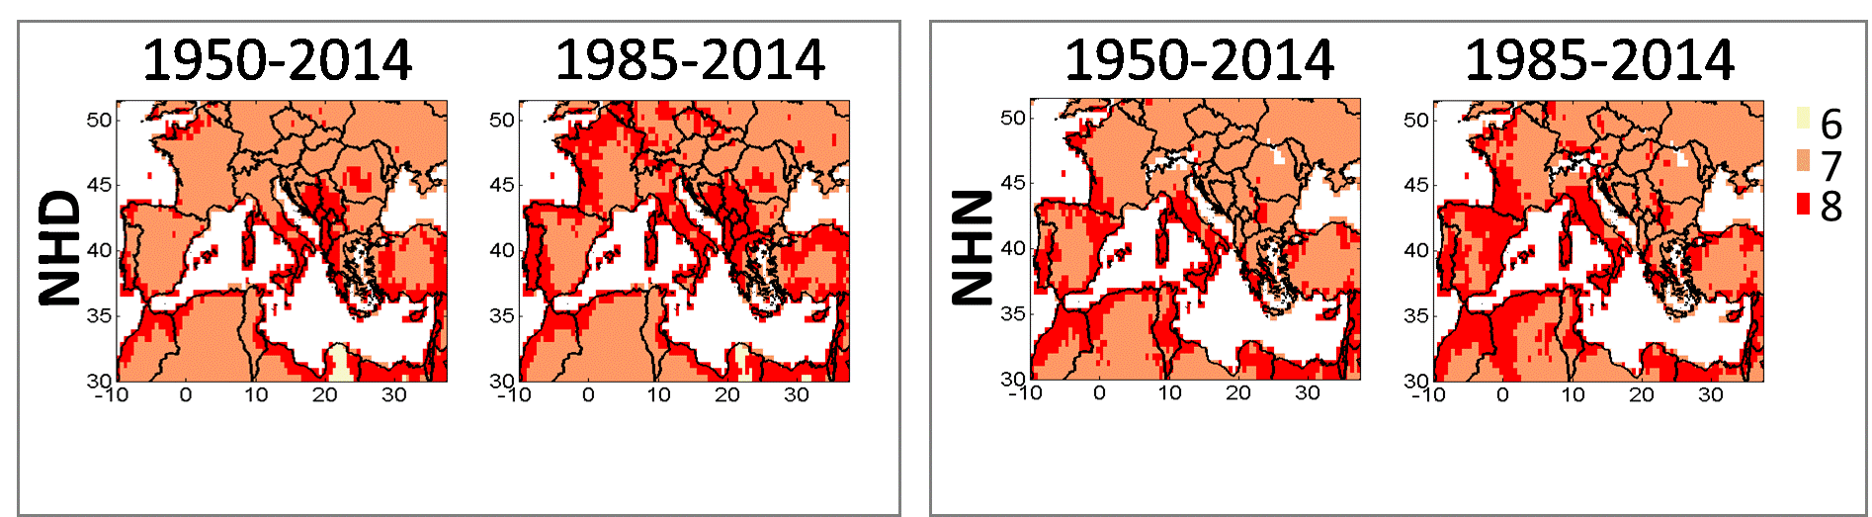
MONTH PRECEDING THE HOTTEST MONTH
The hottest month was determined for each year
The most frequent hottest months are either July or August
Results differ between using 1950-2014 or 1985-2014 and Tmax or Tmin
CORRELATION ANALYSIS (Pearson) between the hottest month NHD/NHN and the preceding months’ SPI/SPEI

Slide 8
CORRELATIONS’ RESULTS
NHD 1950-2014
The magnitude of correlations of the NHD and the preceding 3-month SPEI/SPI are usually higher
Correlations between the NHD with SPI and SPEI differ, with SPEI characterized by slightly higher values observed usually for the 3-months time-scale
SPEI
SPI
Statistically significant at 95%

Slide 9
CORRELATIONS’ RESULTS
NHD 1985-2014
SPEI
SPI
Statistically significant at 95%

Slide 10
CORRELATIONS’ RESULTS
NHN 1950-2014
SPEI
SPI
Statistically significant at 95%

Slide 11
CORRELATIONS’ RESULTS
NHN 1985-2014
SPEI
SPI
Statistically significant at 95%

Slide 12
CONCLUSIONS
and Future Work
The magnitude of correlations of the NHD/NHN and the preceding 6- and 9-month SPEI/SPI are usually dimmer than for the 3 month time-scale
Correlations between the NHD/NHN with SPI and SPEI differ, with SPEI characterized by slightly higher values observed usually for the 3-months time-scale
Most regions exhibit significantly negative correlations, i.e. high (low) NHD/NHN following negative (positive) SPEI/SPI values, and thus a potential for NHD/NHN early warning
The results for the 1985-2014 period reveal a more regionalized pattern than the ones for the 1950-2014 period particularly for the NHD
The magnitude of change in the drought indices will be assessed using the slope of the regressions of the SPEI and the SPI series with time
Trend analysis
Test ECAD - EOBS v14

Slide 13
Extreme Hot Events Associated to Drought Occurrence
8th EGU Leonardo Conference
Ourense, 24-26 October 2016
over the Southwest Mediterranean
A. Russo, C.M. Gouveia, A.M. Ramos, P. Páscoa, R.M. Trigo
acrusso@fc.ul.pt
Thank you!
This work was supported by the FCT through SFRH/BPD/99757/2014
Notes:
13
13

